Slide 1
Before We Start
Sign-in to your Google Account.

Slide 2
George Memorial Library
Google Docs: A Beginners Guide

Slide 3
Today's Discussion
Outline of Topics
01
What is Google Doc?
02
Exploring the Interface
03
Creating New Documents
04
How Use Google Templates

Slide 4
What is Google Docs?
A cloud-based application!
Google Docs is part of Google Workspace. Google Workspace is a collection of cloud-based productivity and collaboration tools developed by Google. It includes well-known applications such as Gmail for email, Google Drive for cloud storage, Google Docs for document creation and editing, Google Sheets for spreadsheets, and Google Slides for presentations. These tools are designed to work seamlessly together, enabling real-time collaboration and easy sharing among users.
Notes:
Pros:
* Keeps your files accessible from anywhere.
* Eliminates the need to email files or the use of a USB Drive.
* Collaborate with others
* Create different types of files.

Slide 5
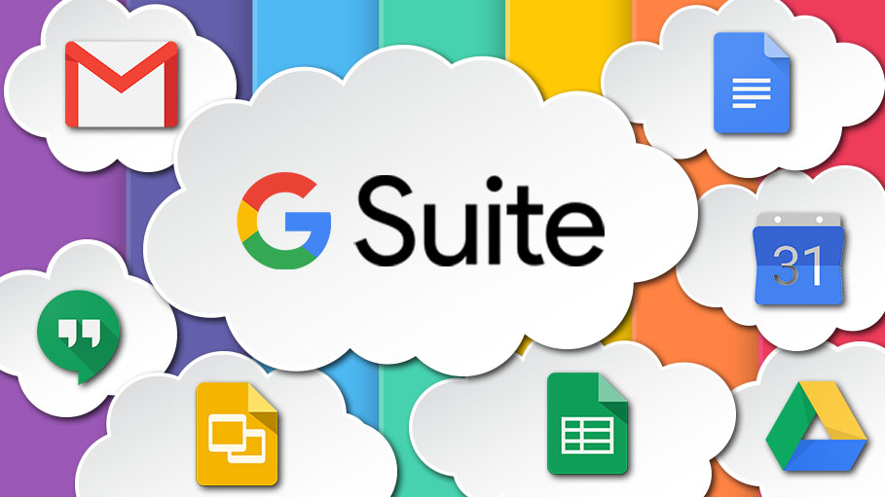

Slide 6
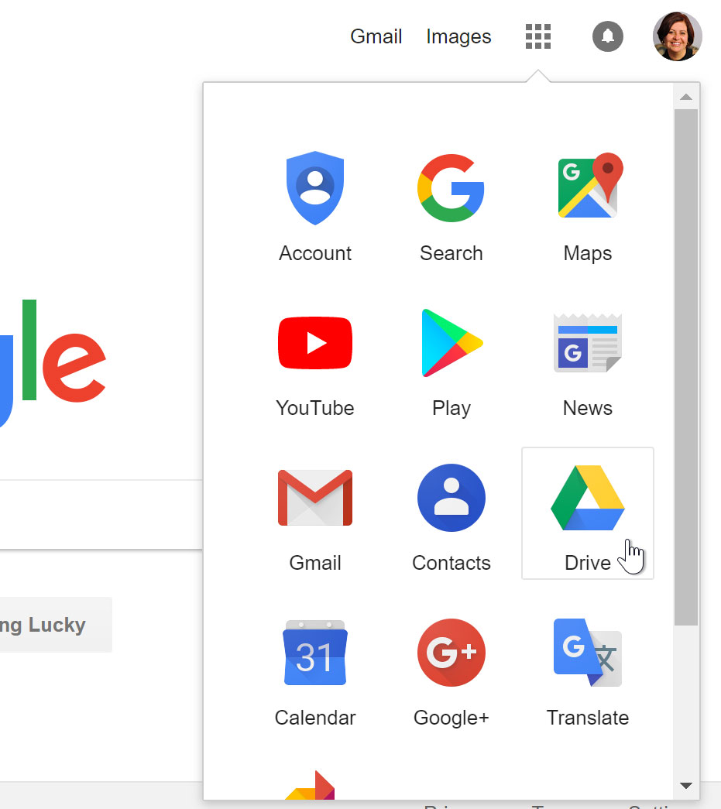

Accessing Google Drive
You can navigate to Google Drive from any Google page by selecting the grid icon near the top-right corner, then clicking Drive.

Slide 7


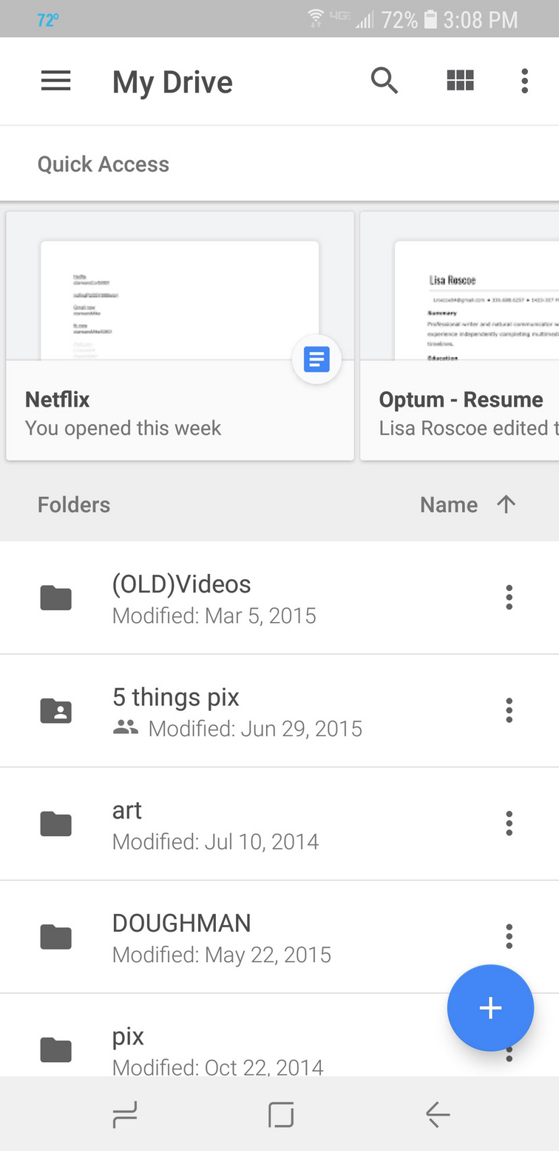
Using the App
Available for both iOS and Android, the Google Drive mobile app allows you to view and upload files to Google Drive using your mobile device. Keep in mind, Google has separate mobile apps for creating and editing documents, spreadsheets, and presentations.

Slide 8
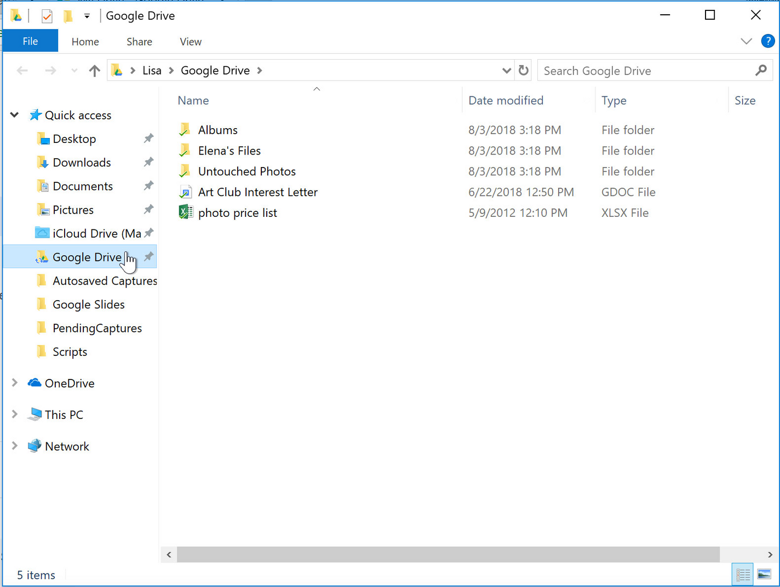
Using the Desktop App
If you prefer to work on the desktop, you can download the Google Drive desktop app to your computer. Once it's installed, you'll see a new Google Drive folder on your computer. Any files you move into this folder will automatically be uploaded to your Google Drive.

Slide 9



Let’s Start Creating!
Notes:
(see class outline) In this part of the presentation, explain to the class how:
*to create files from scratch
*name a file
*to create files from templates
*Download & Print
*Upload files
*Delete Files
*Share & Collaborate

Slide 10
References
GCF Global. (n.d.). Free google docs tutorial at gcfglobal. GCFGlobal.org. https://edu.gcfglobal.org/en/googledocuments/

