Slide 1






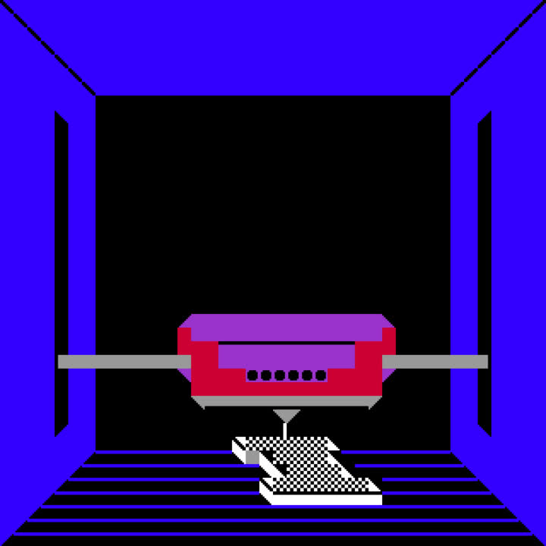
INTRO TO
3D PRINTING
WITH FORT BEND COUNTY LIBRARIES
Notes:
1. Welcome and introduction.
2. Ask the class what they know about 3D printing.

Slide 2
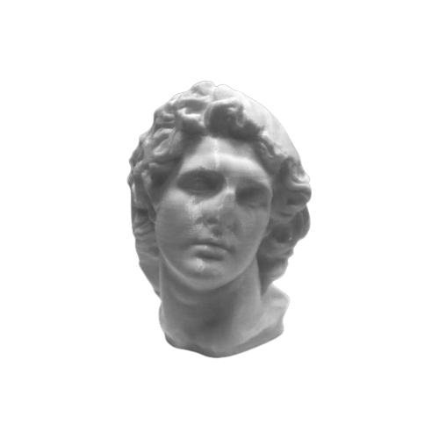





GOALS
LEARN THE BASICS
OF 3D PRINTING
FIND OUT HOW TO
3D PRINT WITH FBCL
GET CONNECTED WITH
3D PRINTING RESOURCES
CREATE YOUR OWN 3D PRINTED OBJECT USING TINKERCAD
Notes:
1. Image: Alexander as Helios by Scan The World on MyMiniFactory.

Slide 3
3D PRINTING
BASICS

Slide 4
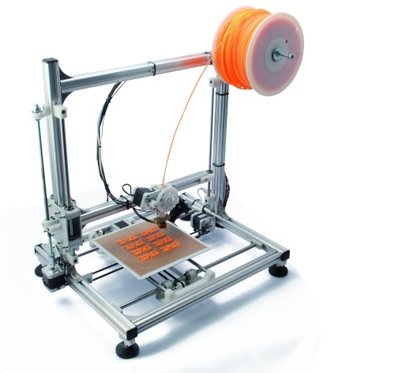
3D PRINTER
  FILAMENT
MATERIAL USED TO CREATE A 3D PRINTED OBJECT
  EXTRUDER
HEATS UP FILAMENT AND DEPOSITS IT IN LAYERS
  BED
SURFACE THAT THE 3D OBJECT IS PRINTED ON

Slide 5
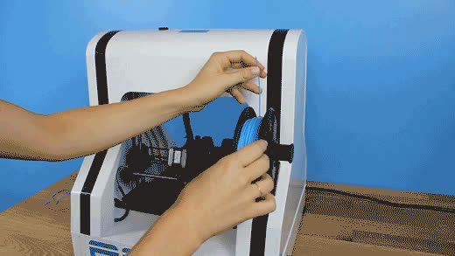

Slide 6
Notes:
1. Filament is added.

Slide 7
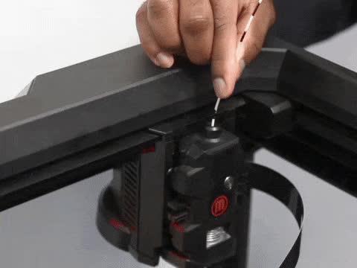
Notes:
1. Filament is fed through extruder.

Slide 8
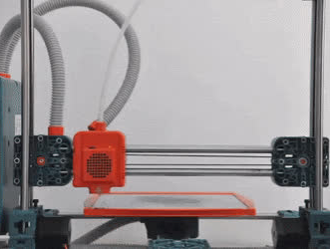
Notes:
1. Extruder lays melted filament down onto the bed layer by layer.
2. Its like an overcomplicated hot glue gun.

Slide 9
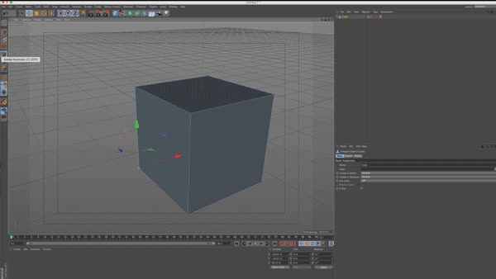
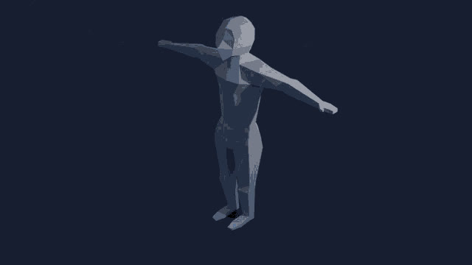
CAD SOFTWARE
  COMPUTER-AIDED DESIGN
  CREATE DIGITAL MODELS IN 2D AND 3D
  USED BY ARCHITECTS, ENGINEERS, AND DESIGNERS ACROSS MANY FIELDS
  MANY APPLICATIONS, INCLUDING 3D PRINTING
Notes:
1. Images: Examples of 3d modeling.

Slide 10
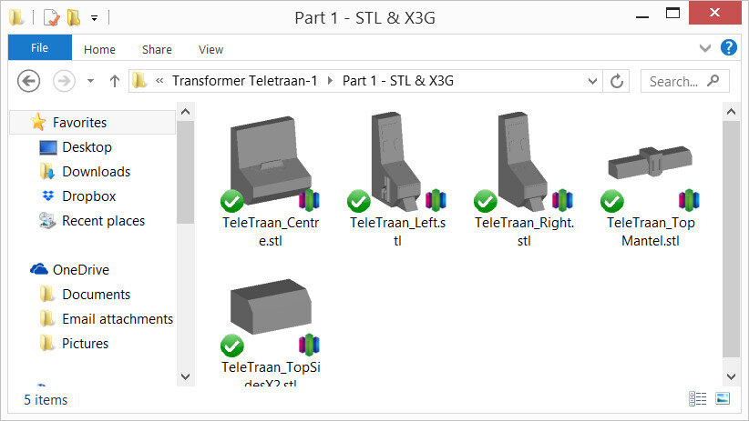
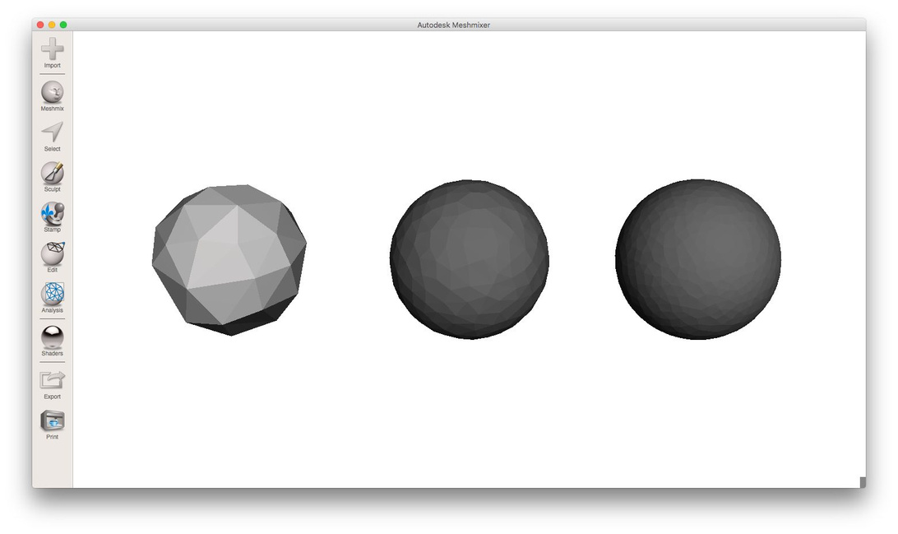
STL FILE FORMAT
  STEREOLITHOGRAPHY: A COMMON METHOD OF 3D PRINTING
  COMMON FILE FORMAT FOR 3D PRINTING
  SAVES
    SHAPES
  DOES NOT SAVE
    COLOR
    TEXTURE
    METADATA
Notes:
1. Image A: Ex. of what an .stl file might look like in the file folder.
2. Image B: Ex. of lower and higher resolutions. (compare to crunchy vs. high-res jpeg)

Slide 11
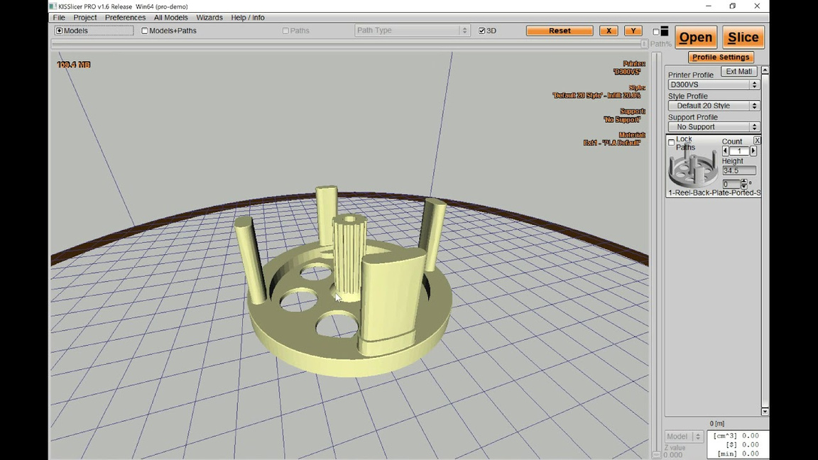
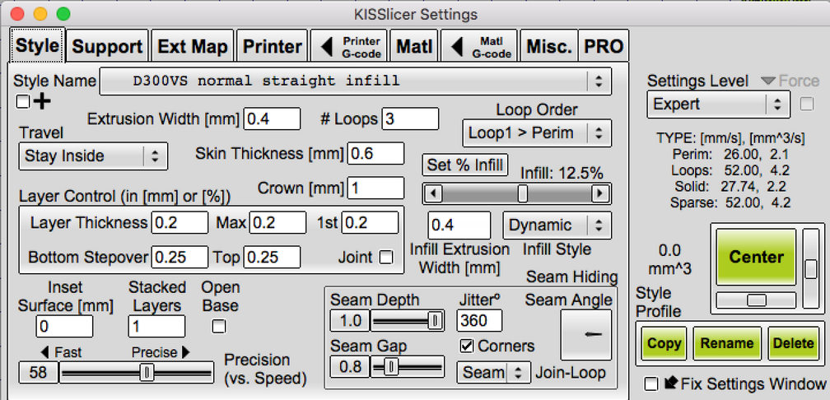
SLICER
  SOFTWARE THAT CONVERTS 3D MODELS INTO PRINTING INSTRUCTIONS
  CREATES 2D LAYERS (SLICES) FROM 3D MODEL FILES
  CONTROLS THE PATH, SPEED, AND TEMPERATURE OF THE PRINT
  CAN ADD STRUCTURAL ADJUSTMENTS:
    INFILL
    SUPPORTS
    BASE LAYERS
Notes:
1. Images: Screenshots of Kisslicer show what a slicer program looks like and how awful the ui is.

Slide 12
Things to Keep in Mind
  A flat bottom is needed to ensure the object sticks to the print bed. Spheres and round bottomed objects wont stick to the print bed.
  Gravity affects the printing process, so overhands or long unsupported bridges will cause a print to fail.
  Size matters! An object that is too small won’t print well, and an object that is too big may not fit on the print bed
Notes:
1. Images: Screenshots of Kisslicer show what a slicer program looks like and how awful the ui is.

Slide 13
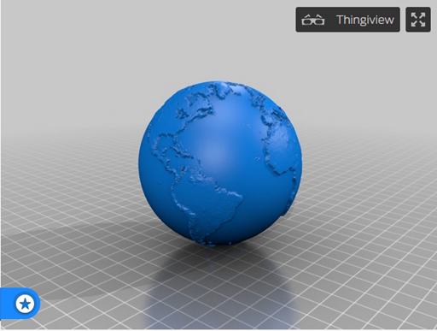
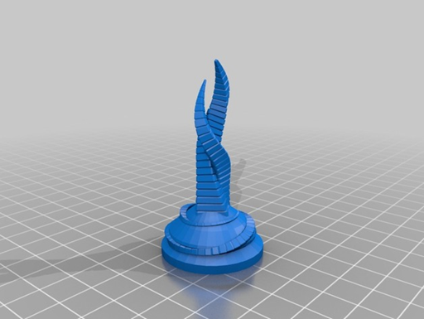

Slide 14
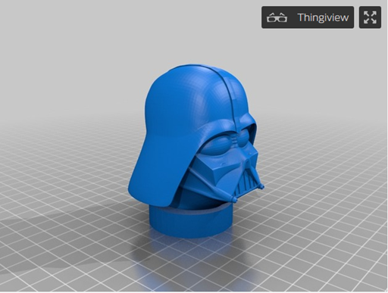
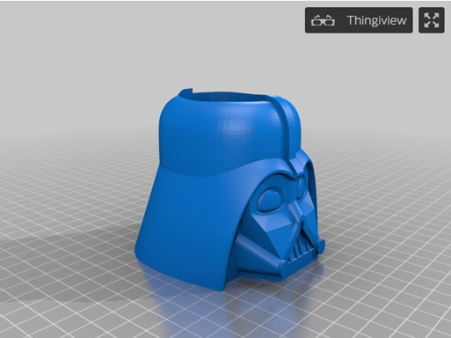

Slide 15
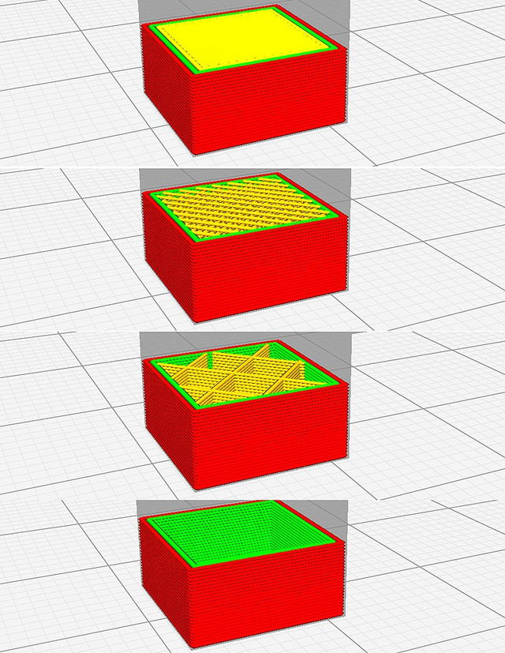
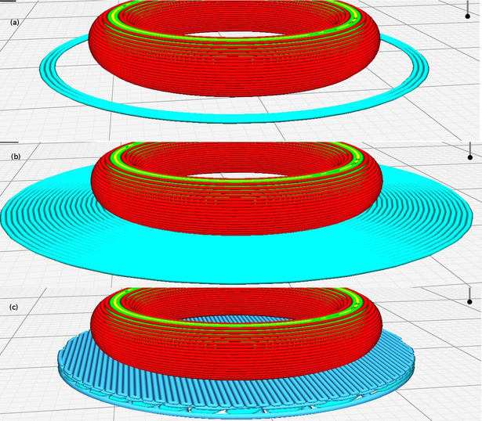
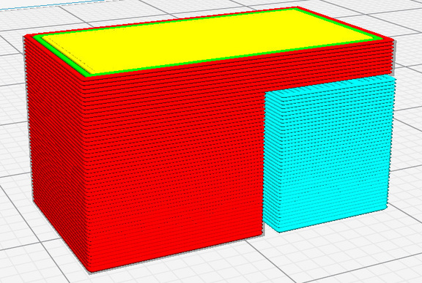

SUPPORT STRUCTURES
SUPPORTS
BASE LAYERS
INFILL
Notes:
1. Infill: The inside of a 3D printed object can be adjusted to reduce time/material but still provide structural support.
2. Base Layers: Skirts, Brims, and Rafts can be added to solve problems like bed adhesion or flow of material.
3. Supports: Vertical supports can be added to horizontal overhangs to avoid sagging and help with self-adhesion.
4. (This page provides more detail about what the slicer can add, but can be skimmed over to save time)

Slide 16



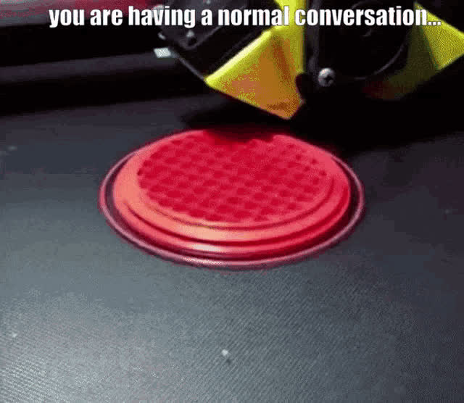
Notes:
1. Image: Example of failed print.

Slide 17
3D PRINTING
WITH FBCL

Slide 18
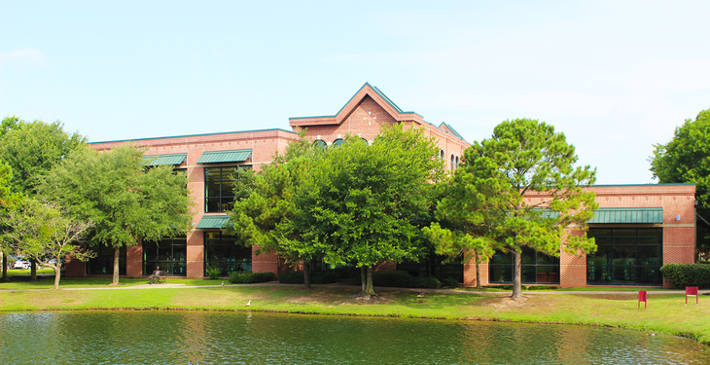
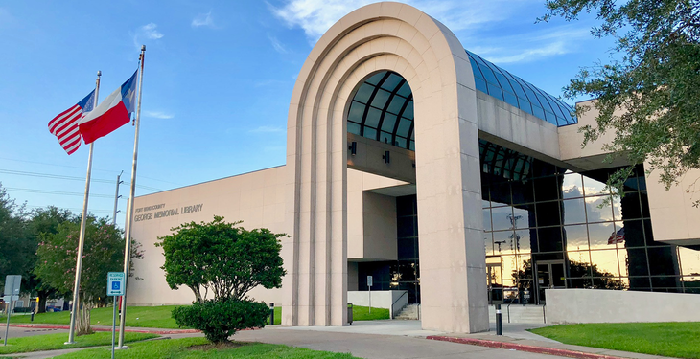

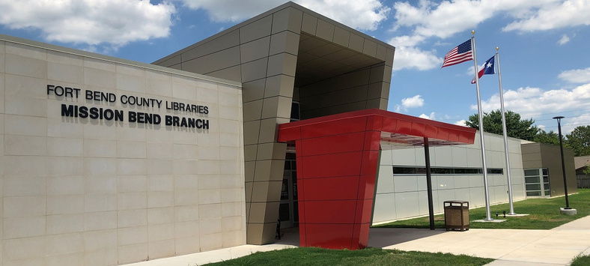



BRANCHES WITH 3D PRINTERS
CINCO RANCH
GEORGE MEMORIAL
MAMIE GEORGE
MISSION BEND
MISSOURI CITY
SIENNA
FULSHEAR

Slide 19
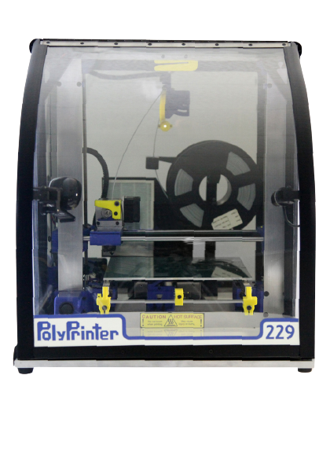
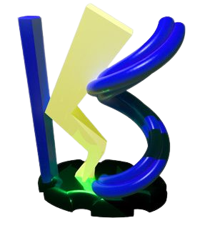
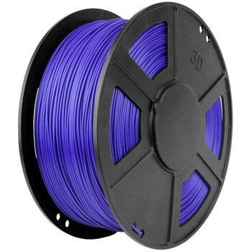
OUR EQUIPMENT
POLYPRINTER 229
PLA FILAMENT
KISSLICER
  HEATED BED
  NON-TOXIC
  ESTIMATES PRINTING TIME
  FULLY ENCLOSED
  BIODEGRADABLE
  RESOLUTION: 0.05MM-0.25MM
  EASILY MELTED (NOT MICROWAVE OR DISHWASHER SAFE)
  CAN ADD SUPPORT STRUCTURES

Slide 20
REQUIREMENTS
PROPERTIES
CONTENT
SUBMISSION
  MAXIMUM SIZE: 8"x 8"x 8"
  NO DANGEROUS, INNAPROPRIATE, OR ILLEGAL OBJECTS
  STL FILES ONLY
  SUBMIT FILE IN-PERSON ON USB/FLASH-DRIVE
  MAXIMUM TIME: 5 HOURS
  NO COPYRIGHTED MATERIAL
  ONE COLOR PER PRINT
  MUST BE PRINT-READY (STAFF CANNOT MODIFY FILES)
Notes:
1. Full policy can be produced upon request.

Slide 21


PRINT NOW!
AT FORT BEND COUNTY LIBRARY
1.00
FIRST 5 GRAMS
0.20
EACH ADDITIONAL GRAM
Notes:
1. Price information, use alternate slide if preferred.

Slide 22
3D PRINTING
RESOURCES

Slide 23



3D OBJECT FILES
SMITHSONIAN
THINGIVERSE
MYMINIFACTORY
3d.si.edu/explore
thingiverse.com
myminifactory.com
Notes:
1. Free object file sources.
2. Mention they should look for files with creative commons license.

Slide 24

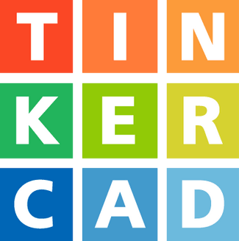

3D MODELING SOFTWARE
BLENDER
TINKERCAD
FUSION 360
Notes:
1. Blender: free, open source, can create 3d models for printing but is not CAD software.
2. Tinkercad: free, available in browser, good for beginners.
3. Fusion 360: costs money, more features, is CAD software.
4. Bonus info: Tinkercad and Fusion 360 are both owned by Autodesk.

Slide 25
3D MODELING
WITH TINKERCAD

Slide 26
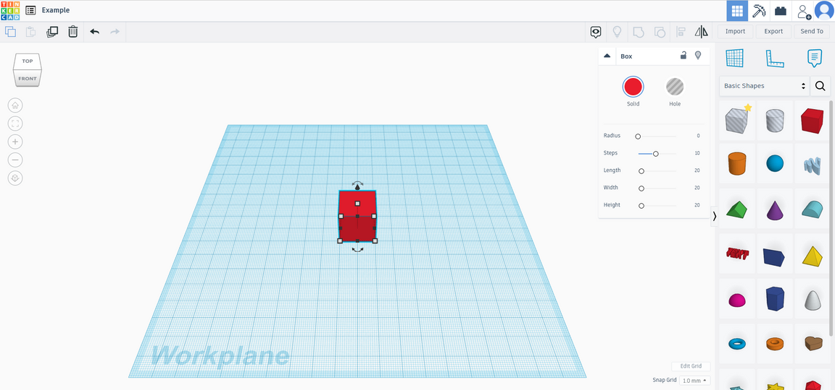
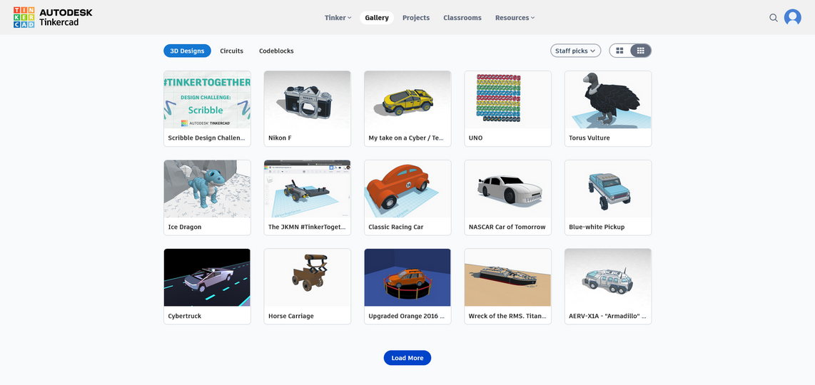
ABOUT TINKERCAD
  FREE TO USE (WITH AN ACCOUNT)
  AVAILABLE IN BROWSER AND MOBILE APP
  CREATE DESIGNS USING A LIBRARY OF PRE-MADE SHAPES
  SHARE AND DOWNLOAD DESIGNS
Notes:
1. Image A: Tinkercad editor window.
2. Image B: Tinkercad gallery.

Slide 27
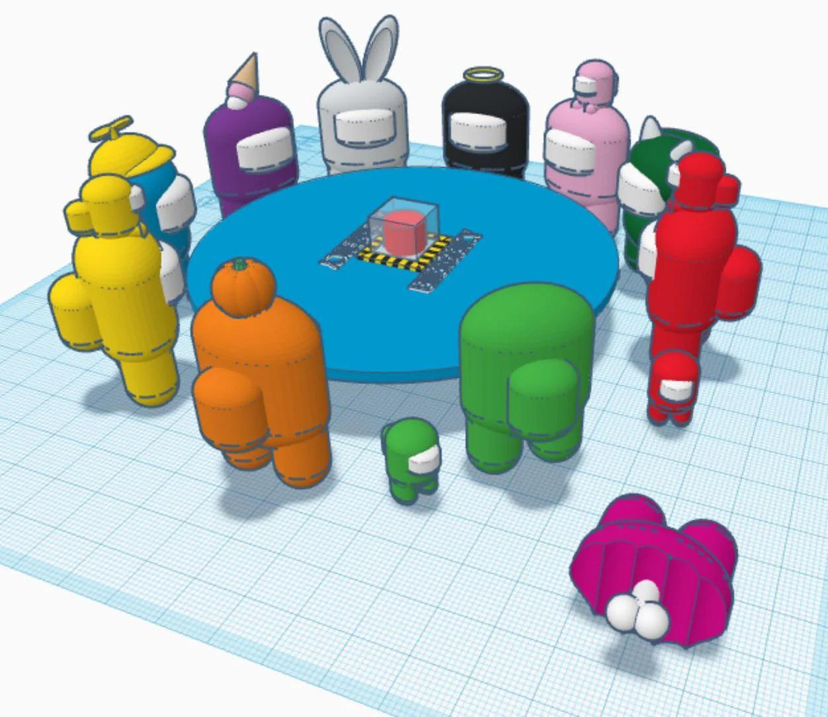
TIPS
  KEEP YOUR OBJECT FLAT AGAINST THE WORKPLANE - NO FLOATING!
  USE A RULER TO COMPARE THE SIZE OF THE MODEL TO REAL WORLD OBJECTS
  COLOR IS A TOOL - THE FINAL PRINT WILL ONLY BE ONE COLOR
Notes:
1. Image: By EricPlayz951 on Reddit

Slide 28
DESK BUDDIES!

Slide 29
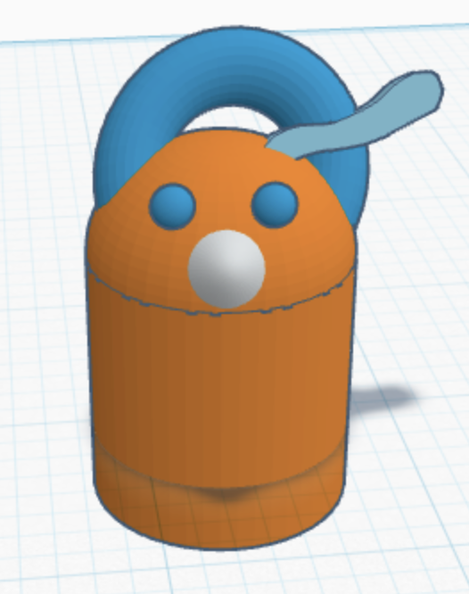
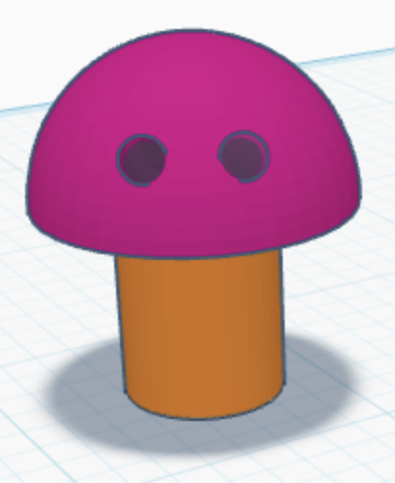
VERY CUSTOMIZABLE!
ALIEN/MONSTER
MUSHROOM
Notes:
1. Blender: free, open source, can create 3d models for printing but is not CAD software.
2. Tinkercad: free, available in browser, good for beginners.
3. Fusion 360: costs money, more features, is CAD software.
4. Bonus info: Tinkercad and Fusion 360 are both owned by Autodesk.

Slide 30
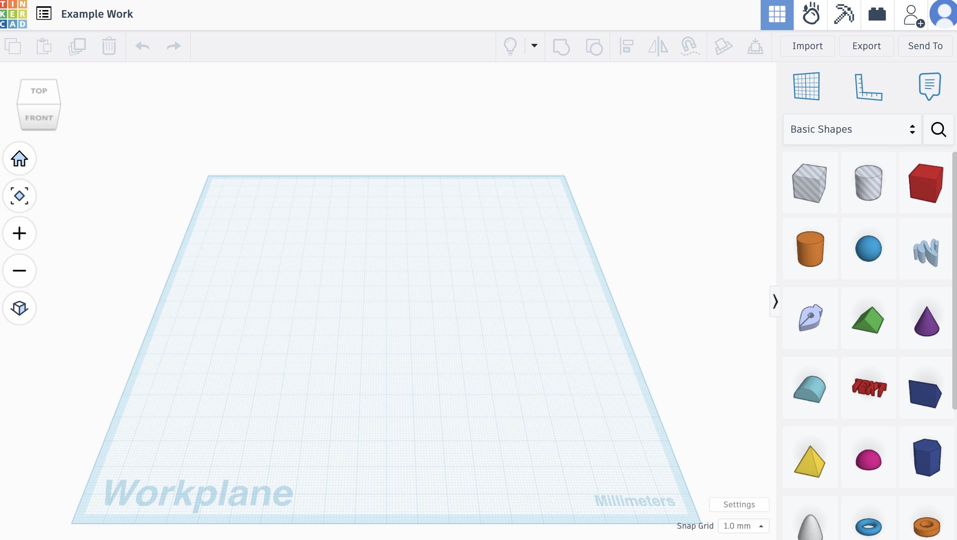
TINKERCAD TIPS
Use these tools to change view. Press home to reset view.
Go to settings to change to Imperial - inches
Notes:
1. Infill: The inside of a 3D printed object can be adjusted to reduce time/material but still provide structural support.
2. Base Layers: Skirts, Brims, and Rafts can be added to solve problems like bed adhesion or flow of material.
3. Supports: Vertical supports can be added to horizontal overhangs to avoid sagging and help with self-adhesion.
4. (This page provides more detail about what the slicer can add, but can be skimmed over to save time)

Slide 31
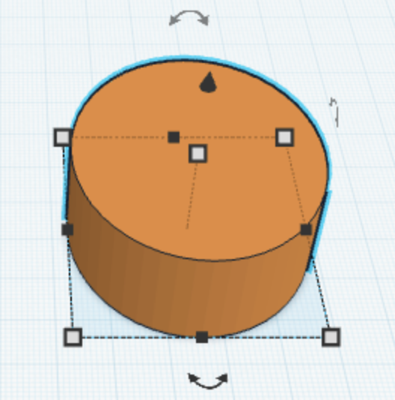
TINKERCAD
Drag here to bring shape up off of Workplane. Press the letter D to drop onto Workplane.
Drag handles to change shape of object. Simultaneously press SHIFT to maintain proportions.
Notes:
1. Infill: The inside of a 3D printed object can be adjusted to reduce time/material but still provide structural support.
2. Base Layers: Skirts, Brims, and Rafts can be added to solve problems like bed adhesion or flow of material.
3. Supports: Vertical supports can be added to horizontal overhangs to avoid sagging and help with self-adhesion.
4. (This page provides more detail about what the slicer can add, but can be skimmed over to save time)

Slide 32
TINKERCAD
These two designs start out with the same basic shapes.
Drag cylinder shape onto workplane. Adjust size using handles (white boxes around shape). Press shift while dragging handles if you want to maintain proportions. Ensure it is touching workplane. (D for drop.)
Drag half sphere directly on top of cylinder. Resize as desired. Be careful that the half sphere shape is not floating above cylinder. With mouse, right click for a better view.
Notes:
1. Infill: The inside of a 3D printed object can be adjusted to reduce time/material but still provide structural support.
2. Base Layers: Skirts, Brims, and Rafts can be added to solve problems like bed adhesion or flow of material.
3. Supports: Vertical supports can be added to horizontal overhangs to avoid sagging and help with self-adhesion.
4. (This page provides more detail about what the slicer can add, but can be skimmed over to save time)

Slide 33
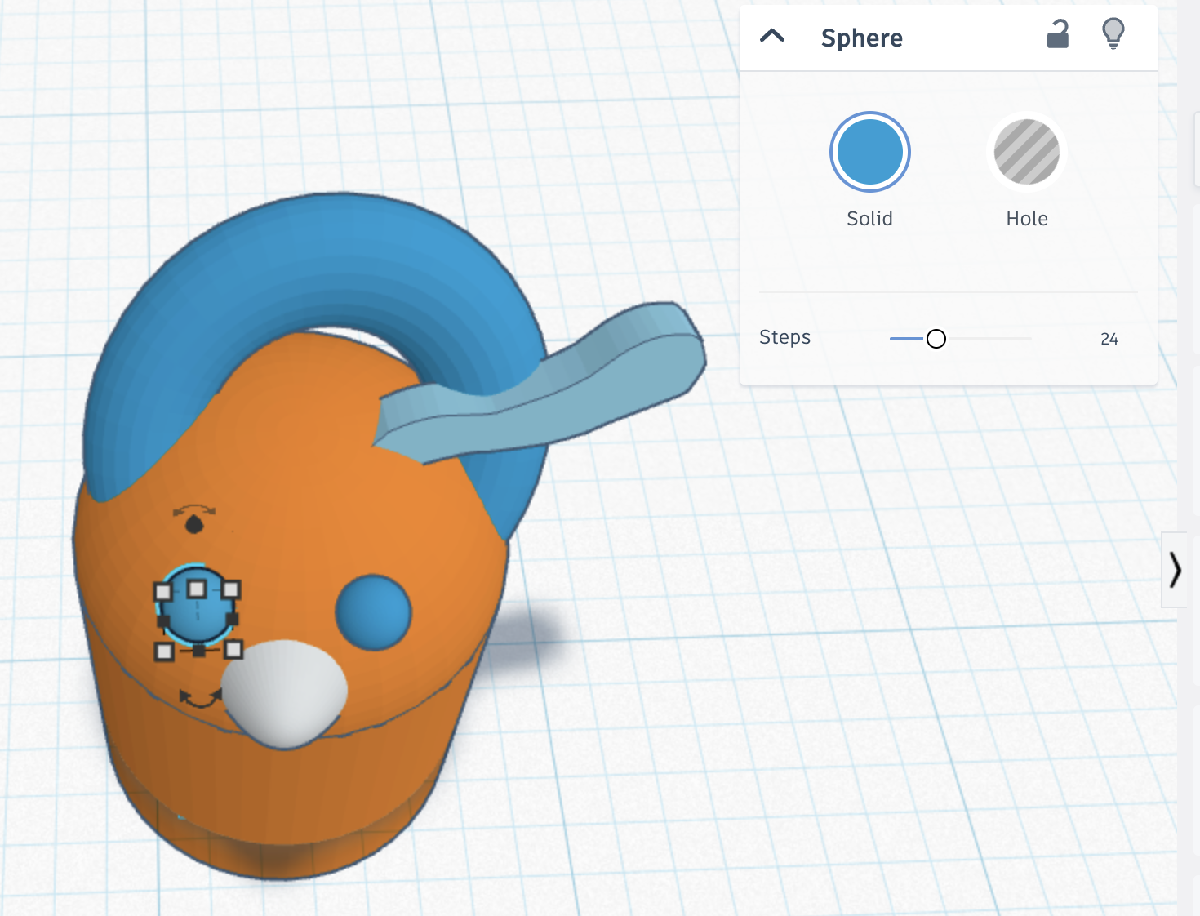
TINKERCAD
Tip: This gives the option to add a solid shape on the design or add a hole into the design.
Notes:
1. Infill: The inside of a 3D printed object can be adjusted to reduce time/material but still provide structural support.
2. Base Layers: Skirts, Brims, and Rafts can be added to solve problems like bed adhesion or flow of material.
3. Supports: Vertical supports can be added to horizontal overhangs to avoid sagging and help with self-adhesion.
4. (This page provides more detail about what the slicer can add, but can be skimmed over to save time)

Slide 34
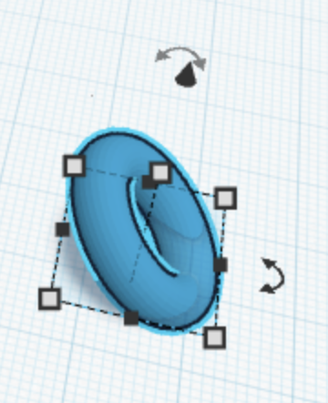
TINKERCAD
Tip: Use curved arrows to alter design orientation AFTER attaching to rest of design.
Tip: Use scribble feature to add custom design elements.
3. Add various shapes to customize eyes and other body parts.
Notes:
1. Infill: The inside of a 3D printed object can be adjusted to reduce time/material but still provide structural support.
2. Base Layers: Skirts, Brims, and Rafts can be added to solve problems like bed adhesion or flow of material.
3. Supports: Vertical supports can be added to horizontal overhangs to avoid sagging and help with self-adhesion.
4. (This page provides more detail about what the slicer can add, but can be skimmed over to save time)

Slide 35
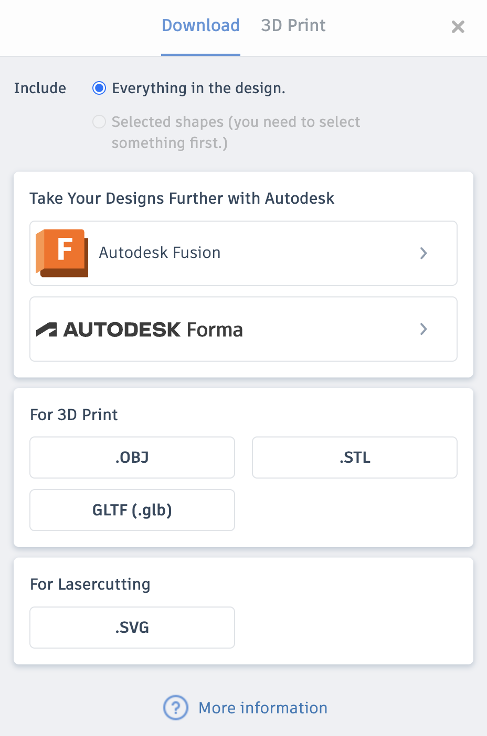
SAVING FILE
4. Click "export" on top right of screen. Save file in the STL format.
Notes:
1. Infill: The inside of a 3D printed object can be adjusted to reduce time/material but still provide structural support.
2. Base Layers: Skirts, Brims, and Rafts can be added to solve problems like bed adhesion or flow of material.
3. Supports: Vertical supports can be added to horizontal overhangs to avoid sagging and help with self-adhesion.
4. (This page provides more detail about what the slicer can add, but can be skimmed over to save time)

Slide 36
EMAIL DESIGNS TO keely.schellbergfbcl@gmail.com
By July 24
Come back on July 30 at 4 PM to paint designs!

