Slide 1
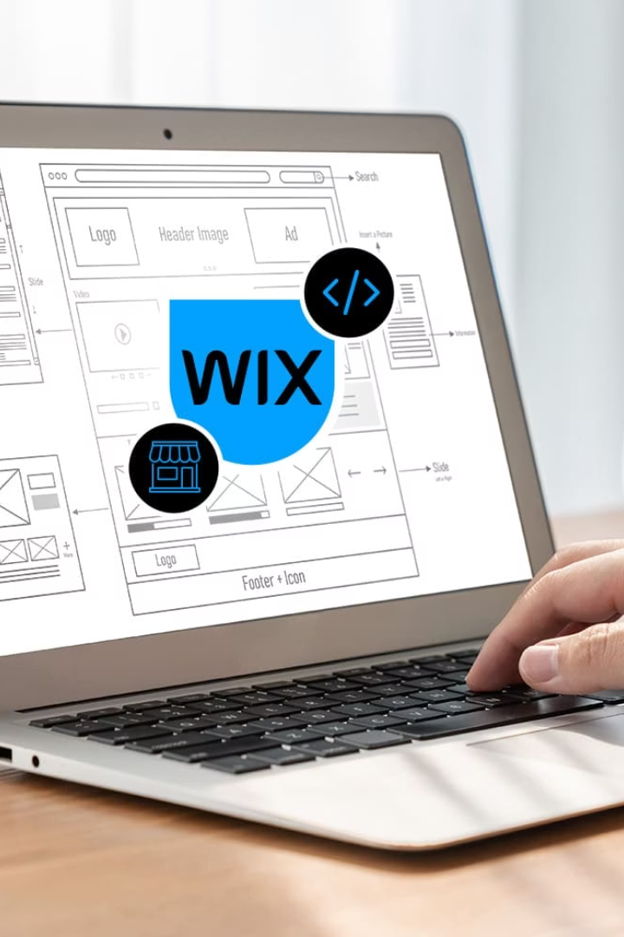
How To Create a Website with Wix
Welcome to this beginner-friendly guide on creating your very first website using Wix! Whether you're a small business owner, artist, blogger, or just someone who wants to establish an online presence, this presentation will walk you through the entire process from start to finish.
No coding experience? No problem! Wix is designed specifically for non-technical users, with a drag-and-drop interface that makes website creation accessible to everyone. By the end of this presentation, you'll have all the knowledge you need to create, customize, and publish your own professional-looking website.

Slide 2
What is Wix?
Wix is a cloud-based website builder platform that has revolutionized the way people create websites. Founded in 2006, it now powers over 200 million websites worldwide. The platform combines ease of use with powerful features, making it perfect for beginners while still offering advanced capabilities as your skills grow.
Drag & Drop
No Coding Required
Mobile Responsive
App Market
Intuitive editor that lets you design by simply dragging elements where you want them
Extend your site with hundreds of apps for everything from online stores to booking systems
Build professional websites without knowing HTML, CSS, or any programming language
Your site automatically adapts to look great on smartphones and tablets

Slide 3
Create Your Account
Setting up your Wix account is the first step in your website creation journey. The process is straightforward and takes just a few minutes. Be sure to use an email address you check regularly, as Wix will send important notifications about your site's performance, updates, and security.
Visit Wix.com
1
Open your browser and navigate to the Wix homepage. Look for the "Get Started" button prominently displayed on the page.
2
Sign Up Options
You can create an account using your email address, or sign up with your Google, Facebook, or Apple accounts for faster registration.
Complete Profile
3
Answer a few basic questions about your website goals to help Wix personalize your experience. This helps the platform recommend suitable templates and features.

Slide 4
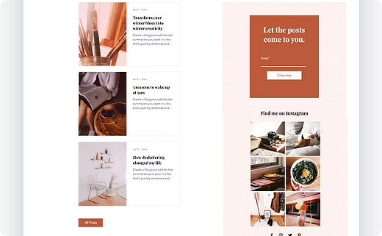
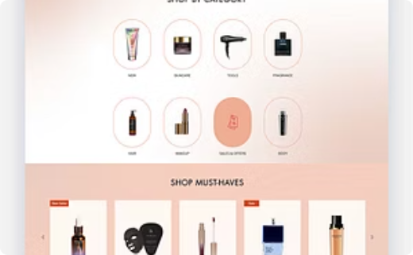
Choose a Template
Wix offers over 800 professionally designed templates across various categories. These templates serve as excellent starting points, providing pre-designed layouts that you can customize to match your brand. You can filter templates by category, such as business, online store, portfolio, or blog, to find one that best fits your needs.
Business Templates
Online Store Templates
Portfolio Templates
Perfect for service providers, consultants, and small businesses looking to establish professional online presence.
Feature-rich templates designed for selling products, with integrated shopping cart and payment processing.
Showcase creative work with templates designed for photographers, artists, designers and other creative professionals.

Slide 5
Editing Text and Images
Select Text Elements
Click on any text box in your template to edit the content. You can change the font, size, color, and alignment using the text editor toolbar that appears.
Update Images
Click on any image to replace it with your own. You can upload from your computer or choose from Wix's free image library with millions of professional stock photos.
Customize Colors
Change your site's color scheme by selecting the "Design" menu and accessing the color palette. Choose colors that match your brand identity.
Arrange Elements
Drag elements to reposition them. Use the handles that appear when an element is selected to resize it or the right-click menu for additional options.
The Wix editor gives you complete freedom to customize every aspect of your website. Remember to maintain consistency in your fonts and colors throughout your site for a professional look. Don't worry about making mistakes – you can always undo changes or revert to previous versions of your site.

Slide 6
Adding Sections
Section Types
Wix offers numerous pre-designed sections including headers, galleries, contact forms, testimonials, pricing tables, and many more that you can add with just a few clicks.
Sections are pre-designed blocks that help you add functionality and visual interest to your website. They save time and ensure a professional look while maintaining design consistency. For beginners, using these ready-made sections is much easier than trying to create complex layouts from scratch.
Adding Sections
Click the "Add" button in the editor menu, then select "Section" to browse through available options. Choose one that matches your needs and click to add it to your page.
Customizing Sections
After adding a section, you can customize it just like any other part of your site. Change colors, images, text, and layout to match your brand and design preferences.

Slide 7
Previewing Your Site
Before publishing your website, it's essential to preview it across different devices. Wix makes this easy with its preview mode, accessible by clicking the "Preview" button at the top right of the editor. This allows you to see exactly how your site will look to visitors using various devices.
While previewing, test all your links, forms, and interactive elements to ensure everything works correctly. Pay special attention to the mobile view, as many visitors will access your site from smartphones.
Desktop View
Tablet View
Mobile View
See how your website will appear on computer screens, which is typically how most visitors will experience your site. Check that all elements are properly aligned and sized.
Preview how your site looks on medium-sized screens like iPads and other tablets. Ensure that your layout adjusts appropriately for these devices.
Verify your site's appearance on smartphones, which is crucial as over 50% of web traffic comes from mobile devices. Check that text is readable and buttons are easy to tap.

Slide 8
Publishing Your Site
Click "Publish"
Choose Domain
Share Your Site
When your site is ready, click the "Publish" button in the top right corner
Select a free Wix subdomain or connect your own custom domain
Promote your new website on social media and other channels
Publishing your website makes it live and accessible to anyone on the internet. This exciting step transforms your hard work into a real online presence. The process is simple: just click the "Publish" button in the editor, and Wix will handle all the technical aspects of making your site live.
Once published, you'll receive a confirmation along with the URL where your site can be accessed. This is a good time to do a final check of your site on the live domain to ensure everything appears and functions as expected.

Slide 9
Free vs Paid Domains
Free Domain
Custom Domain
username.wixsite.com/sitename
yourbusiness.com
No cost
Professional appearance
Includes Wix branding
Better branding
Less professional appearance
Easier to remember
Harder for visitors to remember
Requires premium plan
Email Features
SEO Benefits
Professional email addresses
Search engine advantages
you@yourbusiness.com
Better rankings
Increased credibility
More credibility
Available with some plans
Improved brand recognition
One of the most important decisions for your website is whether to use a free Wix subdomain or invest in a custom domain. While free domains allow you to launch without cost, custom domains provide a more professional appearance and better branding opportunities.
If you're serious about your online presence, a custom domain is highly recommended. It's more memorable for visitors and adds credibility to your business or personal brand. Wix offers domain registration as part of their premium plans, making it easy to secure your ideal web address.

