Slide 1
Microsoft PowerPoint
Intermediate
GEORGE MEMORIAL LIBRARY

Slide 2
Learning Objectives
Applying Themes
Transitions
Animations
Images
Shapes
Videos
Audio

Slide 3
APPLYING THEMES
Notes:
To create a blank presentation:
1. Select the File tab to go to Backstage view.
2. Select New on the left side of the window, then click Blank Presentation.
3. A new presentation will appear.
Create a presentation from a template.
A template is a predesigned presentation you can use to create a new slide show quickly. Templates often include custom formatting and designs, so they can save you a lot of time and effort when starting a new project.
1. Click the File tab to access Backstage view, then select New.
2. You can click a suggested search to find templates or use the search bar to find something more specific. For example, search for the keyword chalkboard.
3. A preview of the template will appear, along with additional information on how the template can be used.
4. Click Create to use the selected template.

Slide 5
To apply a theme:
Select the Design tab on the Ribbon, then locate the Themes group. Each image represents a theme.
Click the More drop-down arrow to see all available themes.
Select the desired theme.
The theme will be applied to the entire presentation. To apply a different theme, simply select it from the Design tab.
Once you've applied a theme, you can also select a variant for that theme from the Variants group. Variants use different theme colors while preserving a theme's overall look.

Slide 6
Challenge
STEP 1
Apply the Gallery theme, which has a light background with a wood texture at the bottom. Note: Theme names will appear when you hover over them.
STEP 2
Select a variant of the theme.

Slide 7
TRANSITIONS
Notes:
To create a blank presentation:
1. Select the File tab to go to Backstage view.
2. Select New on the left side of the window, then click Blank Presentation.
3. A new presentation will appear.
Create a presentation from a template.
A template is a predesigned presentation you can use to create a new slide show quickly. Templates often include custom formatting and designs, so they can save you a lot of time and effort when starting a new project.
1. Click the File tab to access Backstage view, then select New.
2. You can click a suggested search to find templates or use the search bar to find something more specific. For example, search for the keyword chalkboard.
3. A preview of the template will appear, along with additional information on how the template can be used.
4. Click Create to use the selected template.

Slide 8
About
Transitions
SUBTLE
EXCITING
DYNAMIC CONTENT
These are the most basic types of transitions. They use simple animations to move between slides.
These use more complex animations to transition between slides. While they're more visually interesting than Subtle transitions, adding too many can make your presentation look less professional.
f you're transitioning between two slides that use similar slide layouts, dynamic transitions will move only the placeholders, not the slides themselves.

Slide 9
To apply a transition:
Select the desired slide from the Slide Navigation pane. This is the slide that will appear after the transition.
Click the Transitions tab, then locate the Transition to This Slide group. By default, None is applied to each slide.
Click the More drop-down arrow to display all transitions.
Click a transition to apply it to the selected slide. This will automatically preview the transition.
Notes:
You can use the Apply To All command in the Timing group to apply the same transition to all slides in your presentation. Keep in mind that this will modify any other transitions you've applied.
Try applying a few different types of transitions to various slides in your presentation. You may find that some transitions work better than others, depending on the content of your slides.

Slide 10
Challenge
STEP 1
With the first slide selected, apply a Push transition from the Subtle category.
STEP 2
Change the Effect Options to push From Right.
STEP 3
Change the Duration to 2.00.
STEP 4
Set the slides to Automatically Advance after 3 seconds, or 00:03.00.
STEP 5
Use the Apply to All command to apply your changes to every slide. Using the Slide Show button at the bottom of your window, play your slideshow.

Slide 11
ANIMATIONS
Notes:
To create a blank presentation:
1. Select the File tab to go to Backstage view.
2. Select New on the left side of the window, then click Blank Presentation.
3. A new presentation will appear.
Create a presentation from a template.
A template is a predesigned presentation you can use to create a new slide show quickly. Templates often include custom formatting and designs, so they can save you a lot of time and effort when starting a new project.
1. Click the File tab to access Backstage view, then select New.
2. You can click a suggested search to find templates or use the search bar to find something more specific. For example, search for the keyword chalkboard.
3. A preview of the template will appear, along with additional information on how the template can be used.
4. Click Create to use the selected template.

Slide 12
About
Transitions
ENTRANCE
EMPHASIS
EXIT
MOTIONS PATHS
These control how the object enters the slide.
These animations occur while the object is on the slide, often triggered by a mouse click.
These control how the object exits the slide.
These are similar to Emphasis effects, except the object moves within the slide along a predetermined path, like a circle.

Slide 13
ANIMATE THIS TITLE
Notes:
To create a blank presentation:
1. Select the File tab to go to Backstage view.
2. Select New on the left side of the window, then click Blank Presentation.
3. A new presentation will appear.
Create a presentation from a template.
A template is a predesigned presentation you can use to create a new slide show quickly. Templates often include custom formatting and designs, so they can save you a lot of time and effort when starting a new project.
1. Click the File tab to access Backstage view, then select New.
2. You can click a suggested search to find templates or use the search bar to find something more specific. For example, search for the keyword chalkboard.
3. A preview of the template will appear, along with additional information on how the template can be used.
4. Click Create to use the selected template.

Slide 14
INSERTING PICTURES
Notes:
To create a blank presentation:
1. Select the File tab to go to Backstage view.
2. Select New on the left side of the window, then click Blank Presentation.
3. A new presentation will appear.
Create a presentation from a template.
A template is a predesigned presentation you can use to create a new slide show quickly. Templates often include custom formatting and designs, so they can save you a lot of time and effort when starting a new project.
1. Click the File tab to access Backstage view, then select New.
2. You can click a suggested search to find templates or use the search bar to find something more specific. For example, search for the keyword chalkboard.
3. A preview of the template will appear, along with additional information on how the template can be used.
4. Click Create to use the selected template.

Slide 15
Inserting Pictures
PICTURE FROM A FILE
INSERTING ONLINE PICTURES
SCREENSHOTS

Slide 16
FORMATTING PICTURES
Notes:
To create a blank presentation:
1. Select the File tab to go to Backstage view.
2. Select New on the left side of the window, then click Blank Presentation.
3. A new presentation will appear.
Create a presentation from a template.
A template is a predesigned presentation you can use to create a new slide show quickly. Templates often include custom formatting and designs, so they can save you a lot of time and effort when starting a new project.
1. Click the File tab to access Backstage view, then select New.
2. You can click a suggested search to find templates or use the search bar to find something more specific. For example, search for the keyword chalkboard.
3. A preview of the template will appear, along with additional information on how the template can be used.
4. Click Create to use the selected template.

Slide 17
Notes:
To create a blank presentation:
1. Select the File tab to go to Backstage view.
2. Select New on the left side of the window, then click Blank Presentation.
3. A new presentation will appear.
Create a presentation from a template.
A template is a predesigned presentation you can use to create a new slide show quickly. Templates often include custom formatting and designs, so they can save you a lot of time and effort when starting a new project.
1. Click the File tab to access Backstage view, then select New.
2. You can click a suggested search to find templates or use the search bar to find something more specific. For example, search for the keyword chalkboard.
3. A preview of the template will appear, along with additional information on how the template can be used.
4. Click Create to use the selected template.

Slide 18
ADDING SHAPES
Notes:
To create a blank presentation:
1. Select the File tab to go to Backstage view.
2. Select New on the left side of the window, then click Blank Presentation.
3. A new presentation will appear.
Create a presentation from a template.
A template is a predesigned presentation you can use to create a new slide show quickly. Templates often include custom formatting and designs, so they can save you a lot of time and effort when starting a new project.
1. Click the File tab to access Backstage view, then select New.
2. You can click a suggested search to find templates or use the search bar to find something more specific. For example, search for the keyword chalkboard.
3. A preview of the template will appear, along with additional information on how the template can be used.
4. Click Create to use the selected template.

Slide 19
To insert a shape:
Select the Insert tab, then click the Shapes command in the Illustrations group. A drop-down menu of shapes will appear.
Select the desired shape.
Click and drag in the desired location to add the shape to the slide.
Notes:
You can use the Apply To All command in the Timing group to apply the same transition to all slides in your presentation. Keep in mind that this will modify any other transitions you've applied.
Try applying a few different types of transitions to various slides in your presentation. You may find that some transitions work better than others, depending on the content of your slides.

Slide 20
INSERTING & FORMATTING VIDEOS
Notes:
To create a blank presentation:
1. Select the File tab to go to Backstage view.
2. Select New on the left side of the window, then click Blank Presentation.
3. A new presentation will appear.
Create a presentation from a template.
A template is a predesigned presentation you can use to create a new slide show quickly. Templates often include custom formatting and designs, so they can save you a lot of time and effort when starting a new project.
1. Click the File tab to access Backstage view, then select New.
2. You can click a suggested search to find templates or use the search bar to find something more specific. For example, search for the keyword chalkboard.
3. A preview of the template will appear, along with additional information on how the template can be used.
4. Click Create to use the selected template.

Slide 21
Notes:
You can use the Apply To All command in the Timing group to apply the same transition to all slides in your presentation. Keep in mind that this will modify any other transitions you've applied.
Try applying a few different types of transitions to various slides in your presentation. You may find that some transitions work better than others, depending on the content of your slides.

Slide 22
INSERTING & FORMATTING AUDIO
Notes:
To create a blank presentation:
1. Select the File tab to go to Backstage view.
2. Select New on the left side of the window, then click Blank Presentation.
3. A new presentation will appear.
Create a presentation from a template.
A template is a predesigned presentation you can use to create a new slide show quickly. Templates often include custom formatting and designs, so they can save you a lot of time and effort when starting a new project.
1. Click the File tab to access Backstage view, then select New.
2. You can click a suggested search to find templates or use the search bar to find something more specific. For example, search for the keyword chalkboard.
3. A preview of the template will appear, along with additional information on how the template can be used.
4. Click Create to use the selected template.

Slide 23
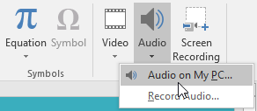
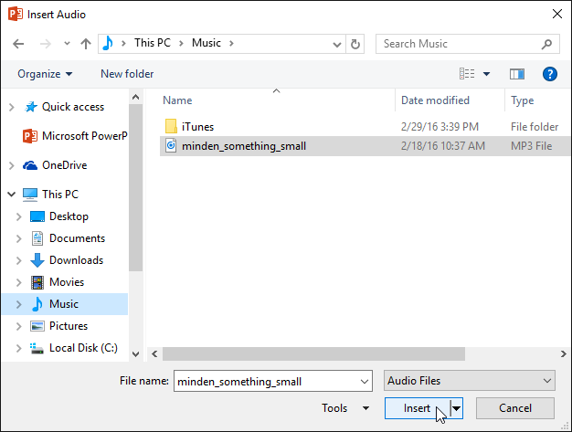
To insert audio from a file
From the Insert tab, click the Audio drop-down arrow, then select Audio on My PC.
Locate and select the desired audio file, then click Insert.
The audio file will be added to the slide.

Slide 24
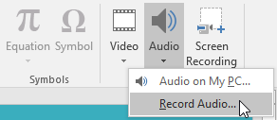
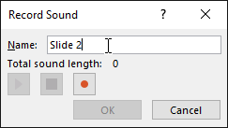
Recording your own audio:
From the Insert tab, click the Audio drop-down arrow, then select Record Audio.
Type a name for the audio recording if you want.
Click the Record button to start recording.
When you're finished recording, click the Stop button.
To preview your recording, click the Play button.
When you're done, click OK. The audio file will be inserted into the slide.

Slide 25
CONGRATULATIONS! YOU HAVE MASTERED POWERPOINT!
ANY QUESTIONS?
Check our online calendar for more computer classes.

