Slide 1

File
Edit
Format
View
BY LAURA LARREGUI
Sugar Land Branch Library
B
I
U
Microsoft Word: Basic

Slide 2
Page 2
LESSON OBJECTIVES
1.
Open new and existing documents.
WHAT YOU'LL LEARN
2.
Copy and paste text.
Format font, paragraphs, and margins
3.
4.
Save and print documents.

Slide 3

Page 3
OVERVIEW OF WORD
Microsoft Word is a popular word processing software that allows you to do things like type letters, resumes, documents, and so much more!

Slide 4
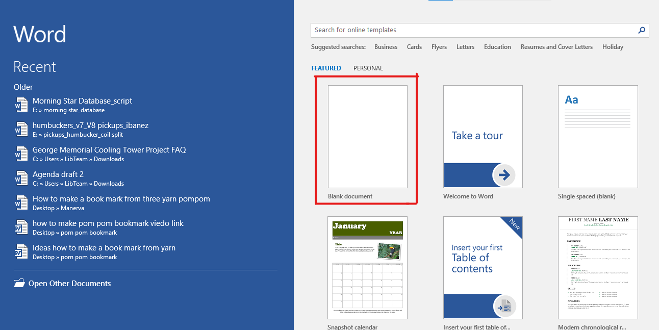
Page 4
WORD INTERFACE
Word Start Screen
Existing Documents
Templates
Notes:
When Word is opened the Word Start Screen will appear
The start screen allows you to create a new document
by choosing from the list of pre-made templates.

Slide 5
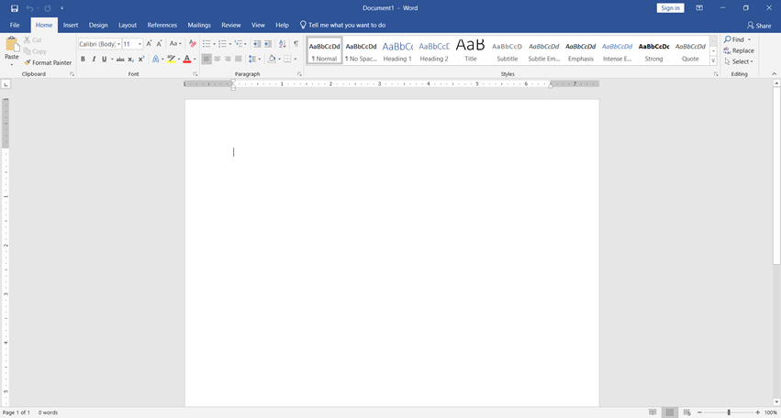
Page 5
WORD INTERFACE
Blank Page Overview
Notes:
When Word is opened the Word Start Screen will appear
The start screen allows you to create a new document
by choosing from the list of pre-made templates.

Slide 6
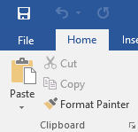
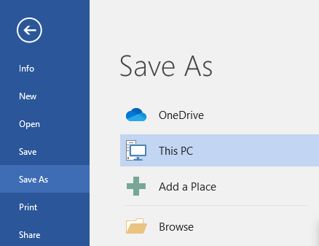
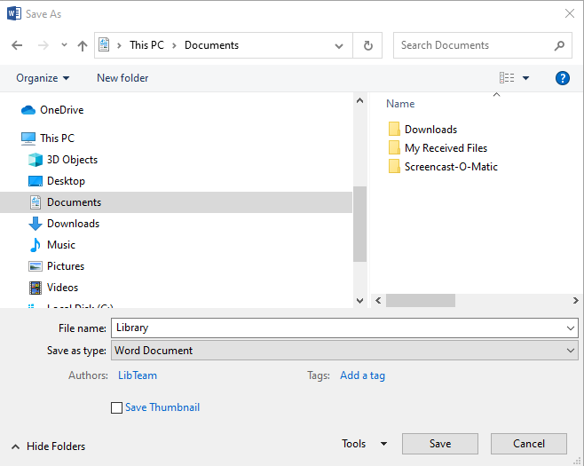
Page 6
ACTIVITY ONE
1.
SAVING A DOCUMENT
  Click on 'File'.
  Click on 'Save As'.
  Choose a location to save your file. For this activity, choose 'Documents'
  Give the document a name. Let's write 'Library'.
  Click 'Save'.
  After saving the first time, click on the floppy disk in the top left corner
2.
3.
4.
5.
Tip: Continually save your document as you work on it.
Notes:
Continually save your document as you work on it.

Slide 7
Page 7
RIBBON
The Ribbon contains multiple tabs, each with several groups of tools. The tools provided in the ribbon will help you complete common tasks in Word.
Notes:
Tip: Since this is a beginner class we only mention a few tabs (the rest will be too advanced, tell learners to ignore the rest for now).

Slide 8
Page 8
RIBBON - HOME
The Home tab gives you access to some of the most commonly used commands for working with Word, including copying and pasting, formatting, aligning paragraphs, and choosing document styles.
Notes:
The Home tab is selected by default whenever you open Word.

Slide 9
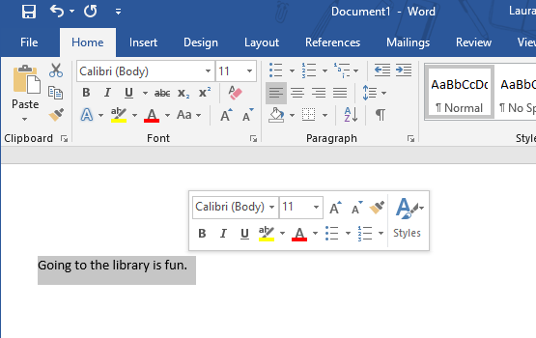

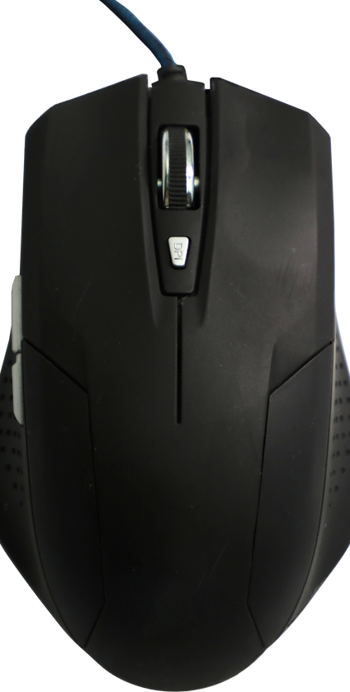

Page 9
ACTIVITY: HIGHLIGHT TEXT
HIGHLIGHT TEXT
  To edit your document you will need to highlight what you want changed.
  How to Highlight Text:
    Move Cursor to the beginning of the text (word, sentence, or paragraph) you want to change.
    Press and hold the left mouse key.
    Move the cursor over the text, and when finished, release the mouse key.
CURSOR
Notes:
Continually save your document as you work on it.

Slide 10
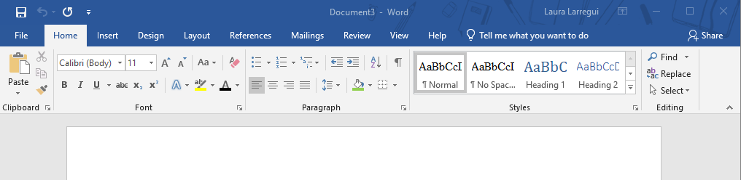
Page 10
FORMATTING TEXT
Clipboard includes:
    Copy
    Cut
    Paste
Font Appearance allows changes to the text in terms of:
    Size
    Style
    Type
    Color
Horizontal alignment includes:
    Left
    Center
    Right
    J u s t i f i e d
Line spacing, which refers to the distance between successive lines of text, is typically adjusted to single- or double-spacing.
Notes:
Changes can be made to all of the text in the document or select portions of it.
Must highlight text in order to perform any of the functions.

Slide 11


Page 11
COPY AND PASTE
x
Cut
Paste
Copy
Notes:
Changes can be made to all of the text in the document or select portions of it.
Must highlight text in order to perform any of the functions.

Slide 12
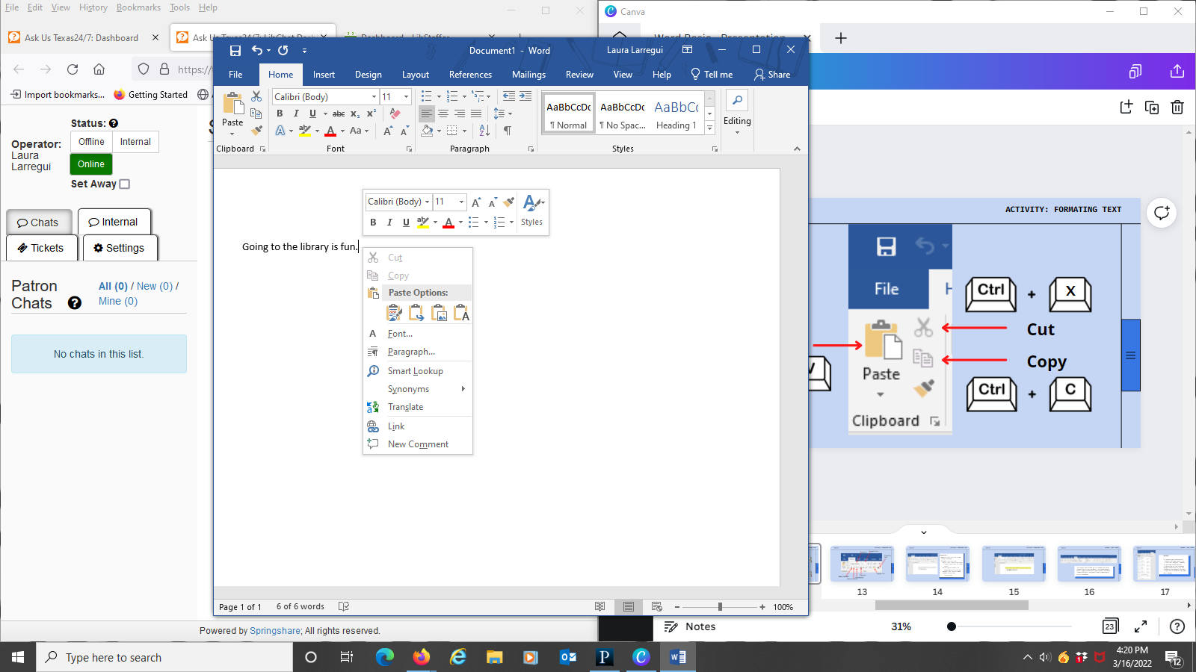
Page 12
EXERCISE 1: COPY AND PASTE
EXERCISE 1
  Select the sentence.
  Copy it.
  Paste it 3 times.
Notes:
Changes can be made to all of the text in the document or select portions of it.
Must highlight text in order to perform any of the functions.

Slide 13
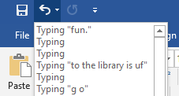
Page 13
UNDO
UNDO ACTIONS
  Undo is another editing function, allowing you to negate the last steps performed.
  The Undo icon appears in the upper left corner, as a backwards facing blue arrow.
  If you make a mistake, click on the undo button. This is a great way to get back to where you started without retyping.
  Keep in mind: You can undo more than just the previous action.
z
Notes:
Changes can be made to all of the text in the document or select portions of it.
Must highlight text in order to perform any of the functions.

Slide 14
Page 14
FONT
Change Font Size
Change Font
Change Font Color
Highlights Text
Strikes Text
Makes Text Bold
Underlines Text
Makes Text Italicized
Notes:
Changes can be made to all of the text in the document or select portions of it.
Must highlight text in order to perform any of the functions.

Slide 15
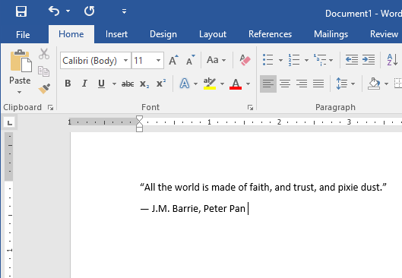
Page 15
EXERCISE 2: FORMATTING TEXT
EXERCISE 2
  Write this text on a new Word Document.
  Format the text by:
    Making the entire text Arial (font) and size 14 (font size).
    The quote should be highlighted in yellow.
    Make J.M. Barrie bold.
    Make Peter Pan italicized.
Notes:
Changes can be made to all of the text in the document or select portions of it.
Must highlight text in order to perform any of the functions.

Slide 16
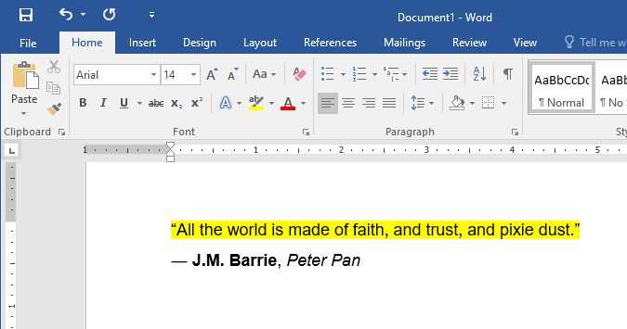
Page 16
ACTIVITY: FORMATING TEXT
Notes:
Changes can be made to all of the text in the document or select portions of it.
Must highlight text in order to perform any of the functions.

Slide 17
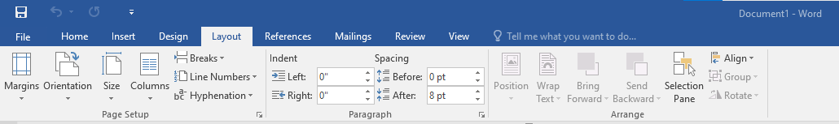
Page 17
RIBBON - PAGE LAYOUT
The Layout tab allows you to change the print formatting of your document, including margin width, page orientation, page breaks, and more. These tools will be helpful when preparing to print a document.

Slide 18
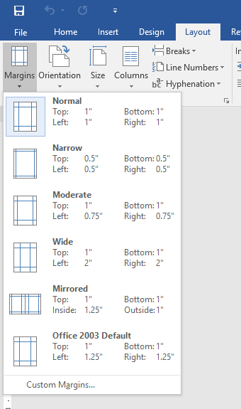
Page 18
RIBBON - PAGE LAYOUT
1.
2.
MARGINS
To change page margins:
1.Select the Page Layout tab.
2.Click the “Margins” command in the Page Setup Section.
3.Select any of the pre-made margin selections or you can customize the margins yourself.
4.Once one is selected the page will change.
3.

Slide 19
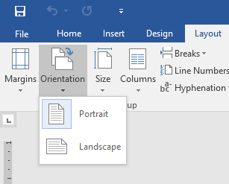
Page 19
RIBBON - PAGE LAYOUT
ORIENTATION
To change page orientation:
1.Select the Page Layout tab.
2.Click the “Orientation” command in the Page Setup Section.
3.A drop-down menu will appear. Click either “Portrait" or “Landscape” to change the page orientation.
4.Once one is selected the page will change.
1.
2.
3.

Slide 20
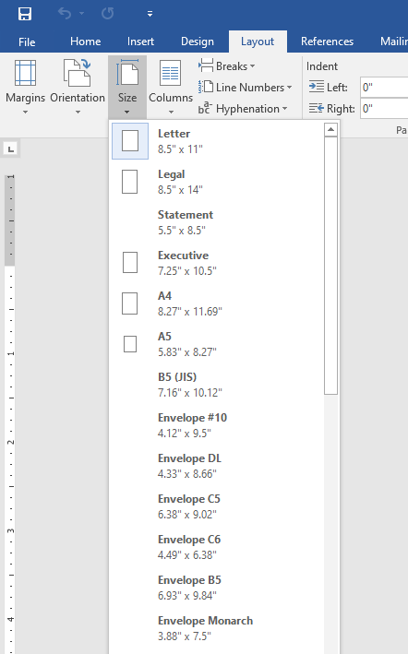
Page 20
RIBBON - PAGE LAYOUT
1.
2.
3.
Page Size
Word has a variety of predefined page sizes to choose from.
1.Select the “Layout” tab, then click the “Size” command.
2.A drop-down menu will appear. The current page size is highlighted

Slide 21
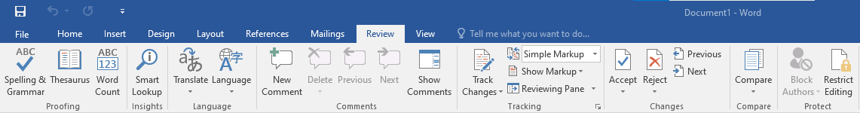
Page 21
RIBBON - PAGE LAYOUT
The Review tab has Word’s powerful editing features, such as spell check, adding comments, and tracking changes. These features make it easy to share and collaborate on documents.

Slide 22
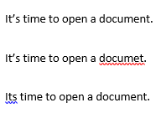
Page 22
RIBBON - PAGE LAYOUT
Text that appears underlined in red has been recognized as a spelling error.
Text that appears underlined in blue has been recognizes as use of the wrong word. Right-click to view suggested solutions.

Slide 23
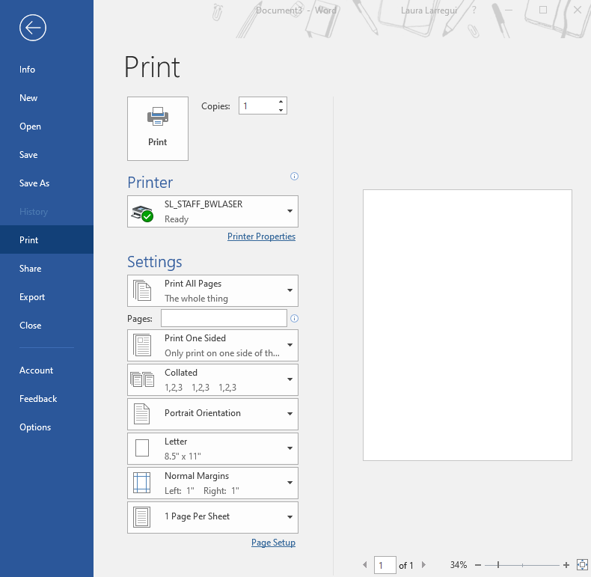
Page 23
ACTIVITY: PRINT DOCUMENTS
1.
3.
PRINTING A DOCUMENT
6.
  Click on 'File'.
  Click on 'Print'.
  Specify how many copies you would like to print.
  Choose the printer you would like to send it to.
  Specify which pages you would like to print.
  Then, click on 'Print'.
Print Preview
4.
2.
5.
Number of pages

Slide 24
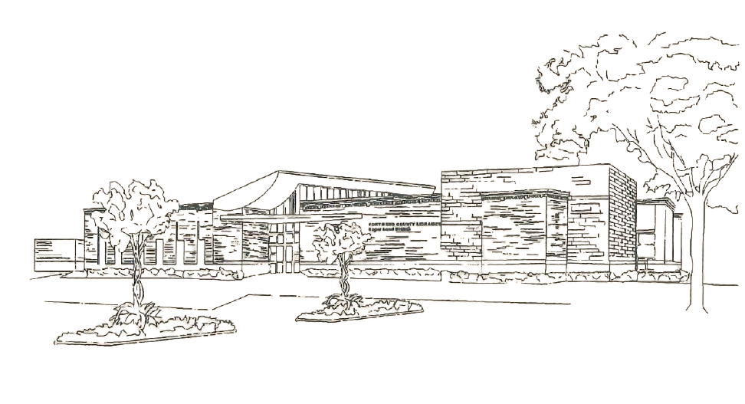
Thank You!
Sugar Land Branch Library

Slide 25


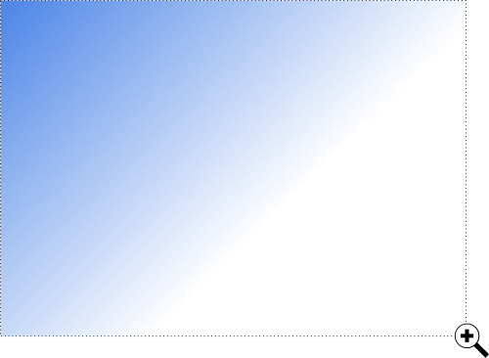

Additional
library resources
Brainfuse Adult Learning Center
Computer Skills Center
from LearningExpress Library
GCFLearnFree.org

Slide 26
Upcoming
Computer Classes
GMAIL for Beginners
MS Excel Basics
April 7
April 21

