Slide 1
Sugar Land Branch Library
Microsoft Excel 2010 Intermediate

Slide 2
Excel
Intermediate
Enter Formulas
Conditional Formatting
What will you learn
IF Statements
Sparklines
Creating and Editing Charts

Slide 3
Formulas

Slide 4
Formulas
Addition +
=A1+A2
Subtraction -
Formulas are always entered with an = sign in the front.
They allow Excel to perform calculations for you.
They greatly diminish the amount of data you must manually enter.
=A1-A2
Multiplication *
=A1*A2
Division /
=A1/A2
Exponentiation ^
=3^4
Percentage %
=23%

Slide 5
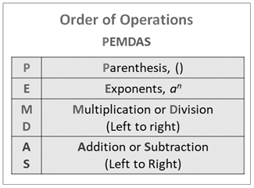

Slide 6
How to Enter Formulas
'Insert Function' button in the formula bar
'AutoSum' button in the Home Tab
Keyboard
Formula Tab

Slide 7
Let's Practice!

Slide 9
Gross Pay = Hours Worked * Hourly Pay Rate
= D4 * E4

Slide 10
Federal Tax = 0.26 * (Gross Pay – Dependents * 22.16)
= 0.26 * (F4-C4*22.16)

Slide 11
State Tax = 0.055 * Gross Pay
= 0.055 * F4

Slide 12
Tax % = (Federal Tax + State Tax)/ Gross Pay
= (G4 + H4) / F4

Slide 13
Net Pay = Gross Pay – (Federal Tax + State Tax)
= F4 - (G4 + H4)

Slide 14
Copy Formulas

Slide 15
Functions

Slide 16
Calculate the Total Using AutoSum

Slide 17
Calculate the Highest Number Using the ‘Insert Function Button’

Slide 18
Calculate the Lowest Number Using the AutoSum Menu

Slide 19
Calculate the Average Using the Formula Tab

Slide 20
Calculate the Total, Highest, Lowest, and Average for Dependents.

Slide 21
Conditional Formatting
Conditional Formatting is special formatting – the font, font color, background fill, and other options – that is applied if cell values meet specified criteria. Excel offers a variety of commonly used conditional formatting rules, along with the ability to create your own custom rules and formatting.
Let's Try It

Slide 23
IF Statements

Slide 24
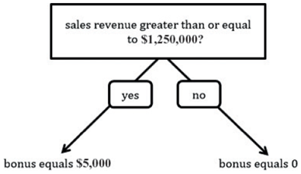

Slide 26
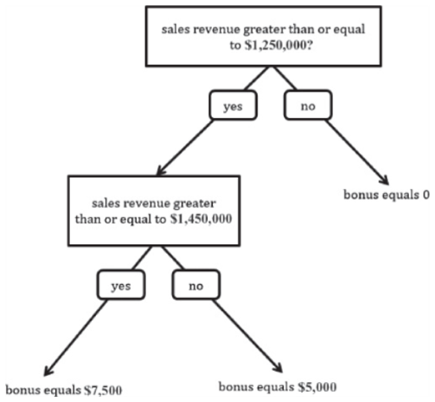
Nested IF
Statement

Slide 28
Sparklines

Slide 29
Sparklines
Sometimes you may want to condense a range of data into a small chart in order to show a trend or variation in the range, and Excel’s standard charts may be too large or extensive for your needs. A sparkline chart provides a simple way to show trends and variations in a range of data within a single cell. Excel includes three types of sparkline charts: line, column, and win/loss.
Let's Try It

Slide 31
Charts

Slide 33
Additional Library Resources
Upcoming
Computer Classes
Brainfuse Adult Learning Center
Computer Skills Center from Learning Express Library
GCFLearnFree.org
Microsoft PowerPoint 2010 Basics
Wed., Nov. 30 @ 10:30 AM
Thu., Dec. 1 @ 6:30 PM
Microsoft PowerPoint 2010 Intermediate
Wed., Dec. 14@ 10:30 AM
Thu., Dec. 15 @ 6:30 PM

Slide 34
Do you have any questions?

