Slide 1
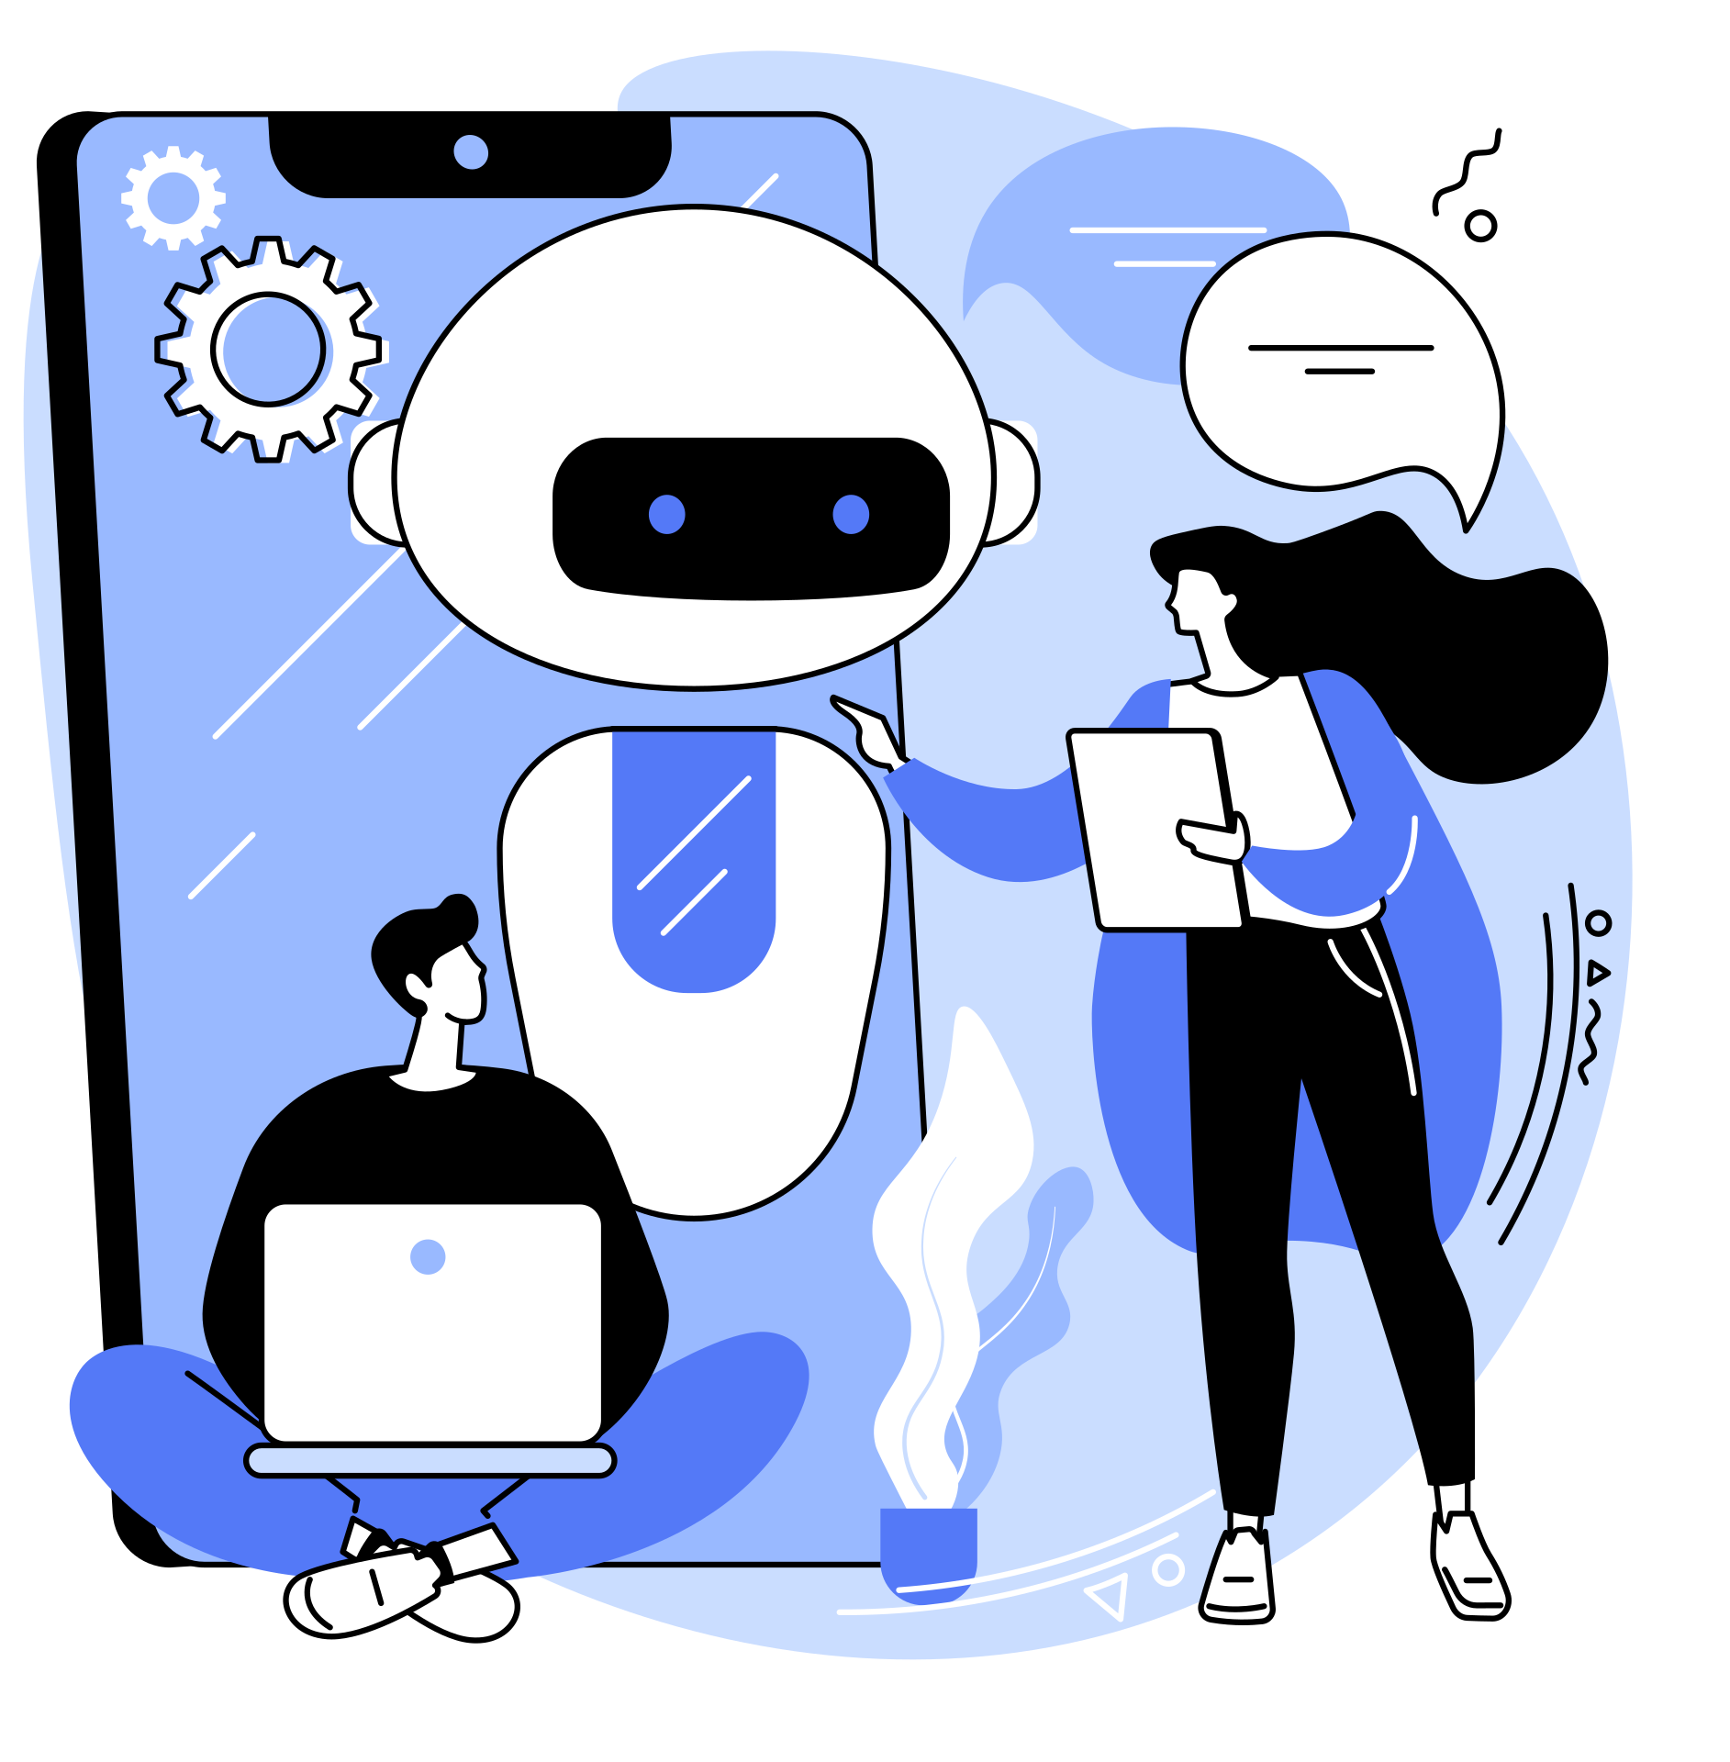
George Memorial Library
CHATGPT 101
Basics, Features, and Practical Applications
Presented by the Audiovisual Department

Slide 2
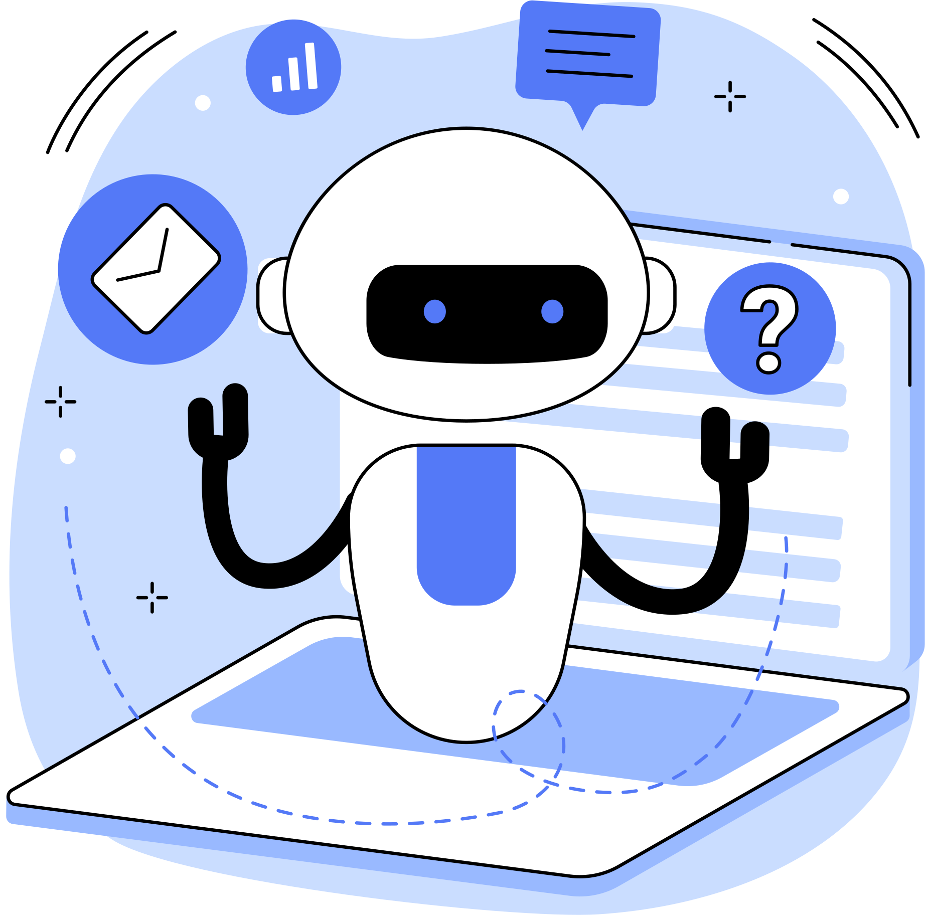
What is ChatGPT?
ChatGPT is an AI language model created by OpenAI that can understand and generate human-like text based on the input it receives. It's designed to have conversations, answer questions, assist with tasks, and more.

Slide 3
Who created ChatGPT and Why?
Inventor
Purpose
Goal
ChatGPT was created by OpenAI, a research organization founded by Sam Altman, Greg Brockman, Ilya Sutskever, and others in 2015.
OpenAI aims to develop safe and useful artificial intelligence for the benefit of humanity.
The creation of ChatGPT was part of OpenAI’s mission to advance the field of NLP and make AI more accessible and useful.
NLP= natural language processing

Slide 4
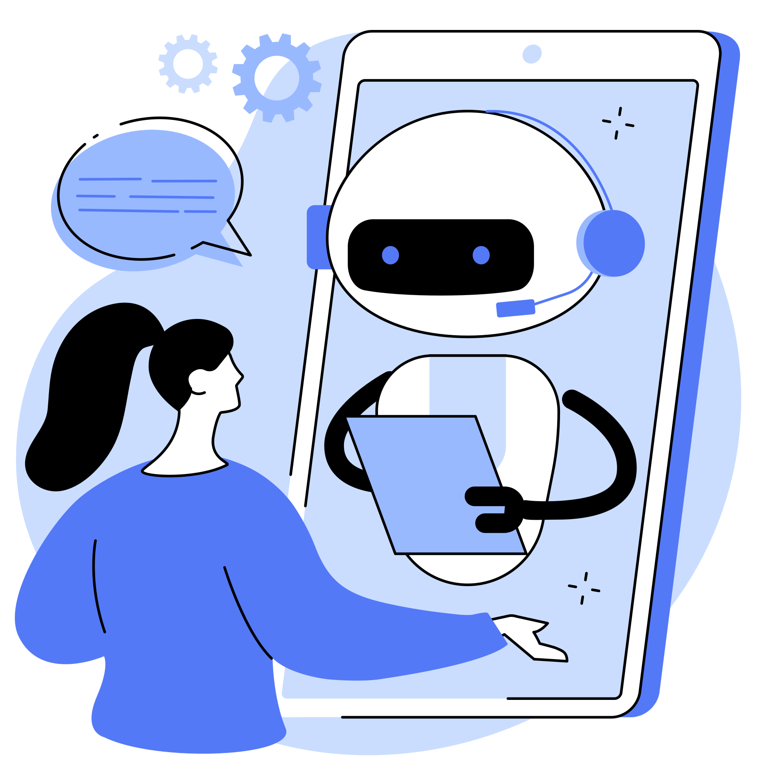
How does it work?
  Artificial Intelligence: Trained on large text datasets.
  Pattern Recognition: Predicts next words based on patterns it learned.
  Not "conscious": It doesn’t “understand” but follows linguistic patterns.
Notes:
Artificial Intelligence Basics: ChatGPT is built on a type of AI called transformers. It’s trained on large datasets containing books, websites, and other texts, so it learns patterns in language and knowledge.
How It Works: Think of ChatGPT like a super-smart parrot. It doesn't "understand" things like humans do but predicts what words or phrases would come next based on patterns it learned. When you ask a question, it looks at the words you've used and tries to give a response that fits well.
Training Process: It's trained by being shown examples of questions and answers (and other types of text), which teaches it to mimic human conversation.

Slide 5
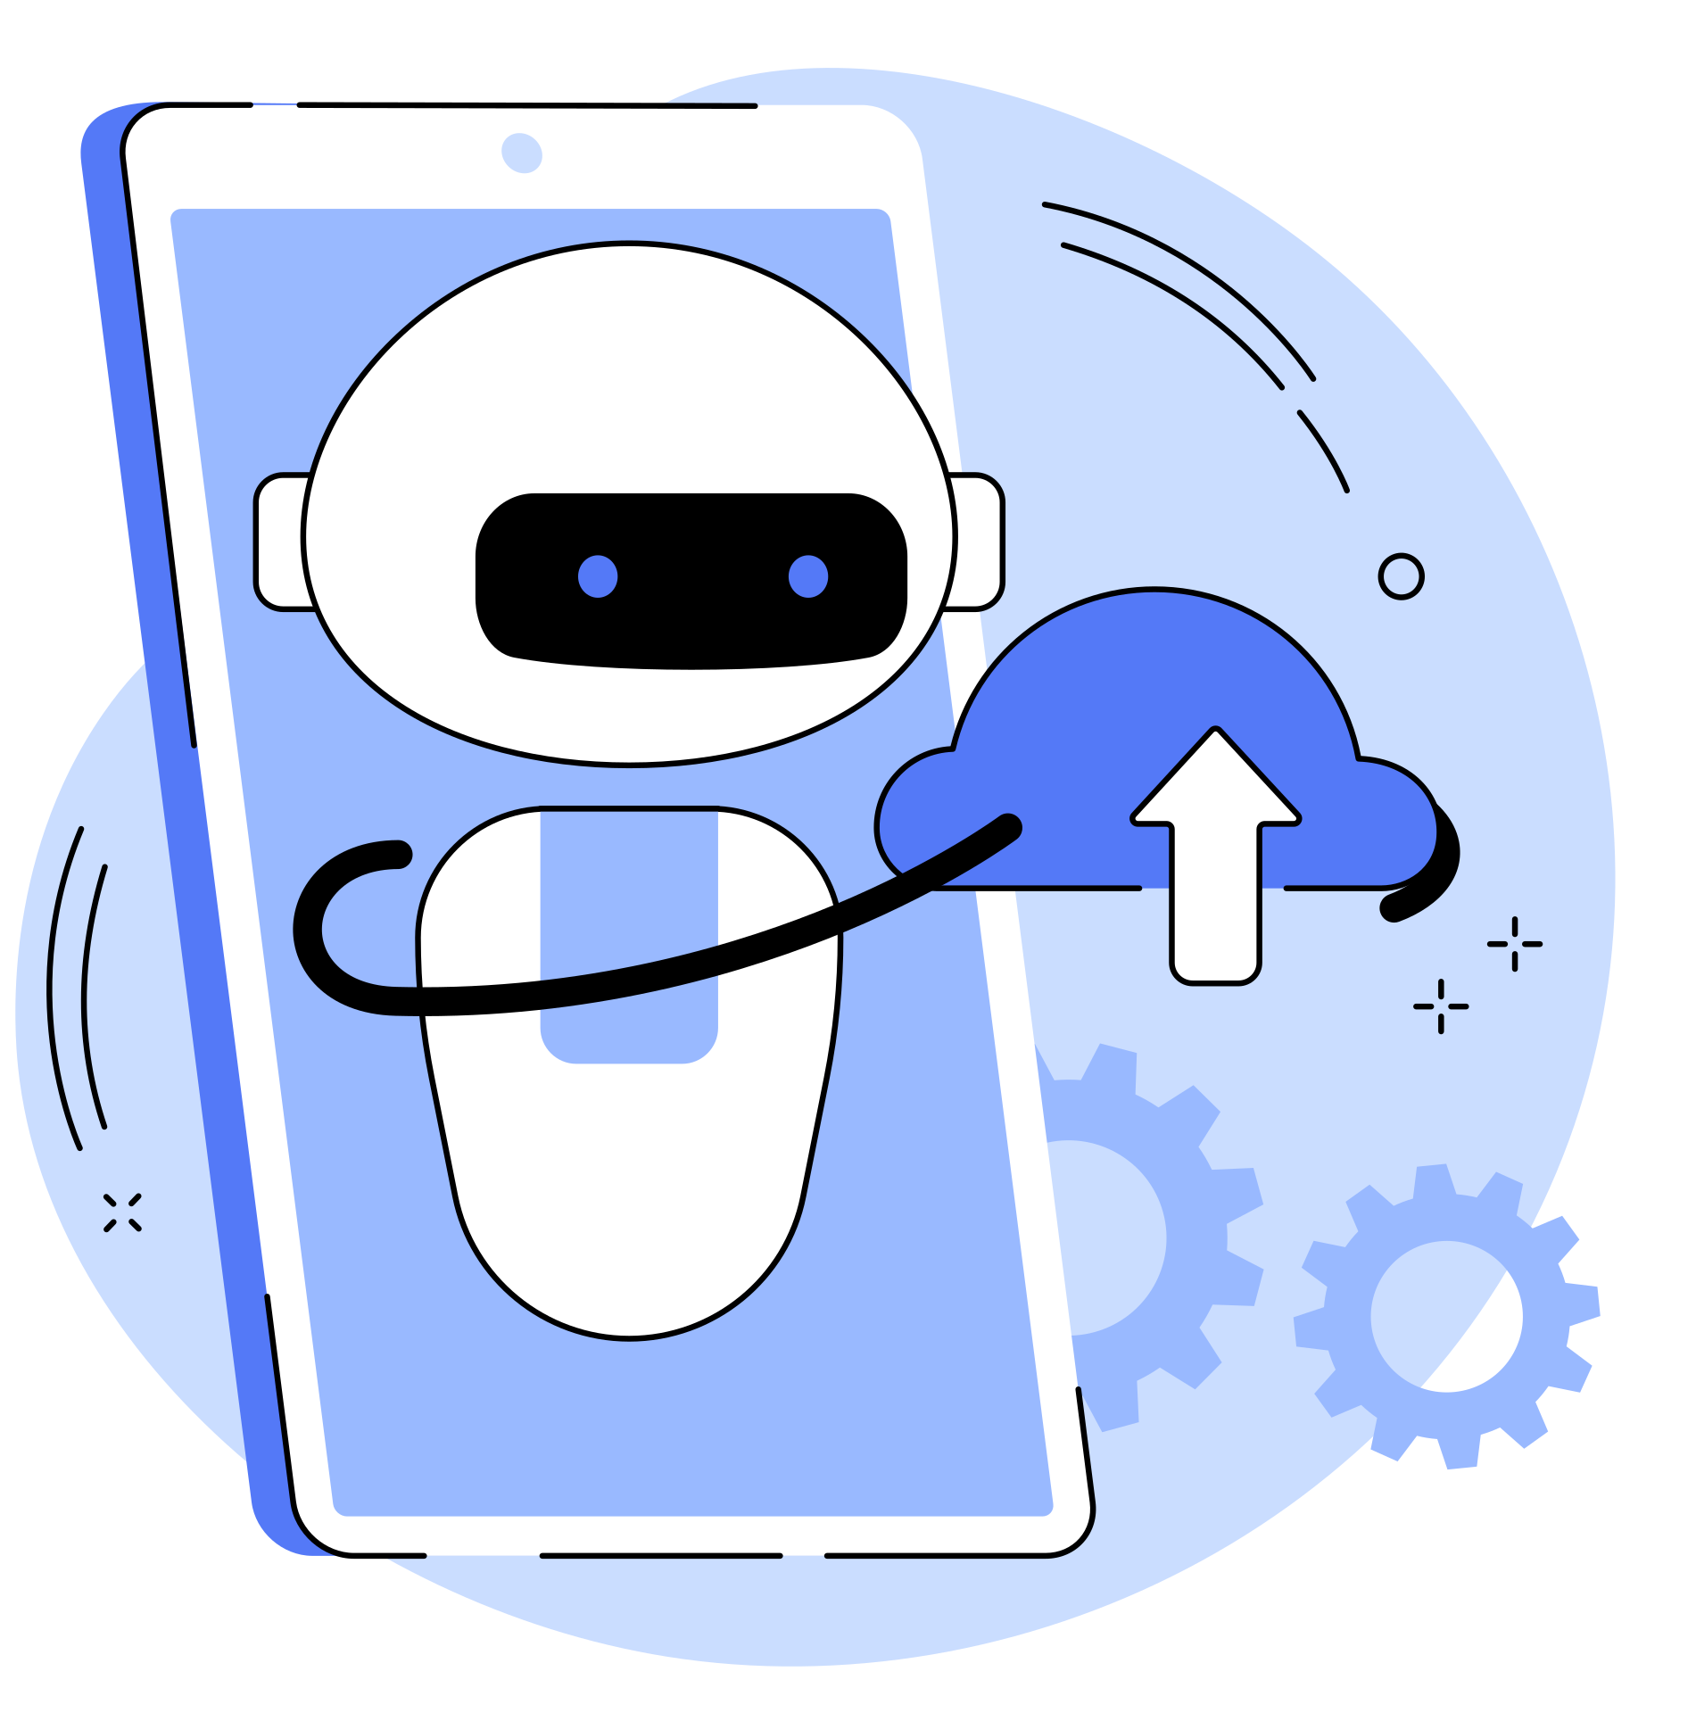
How to access and use Chatgpt?
  Platform: Available via web browser, mobile app.
  Subscription Plans: Free and premium versions (ChatGPT Plus).

Slide 6
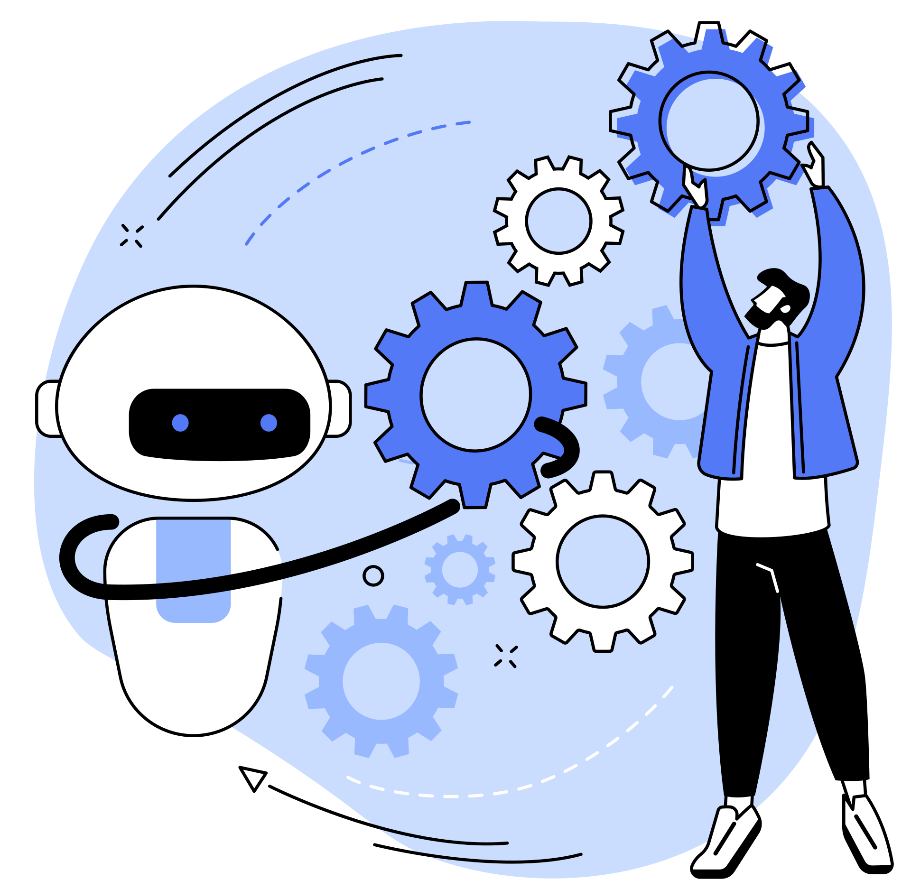
Key Features of ChatGPT
Text Generation
Question Answering
Summarization
Creative Writing
Code Assistance
Conversational Simulation
Translation
Text editors
Creative Writing
Content Creation

Slide 7

Let’s Practice Together!
chatgpt.com

Slide 8
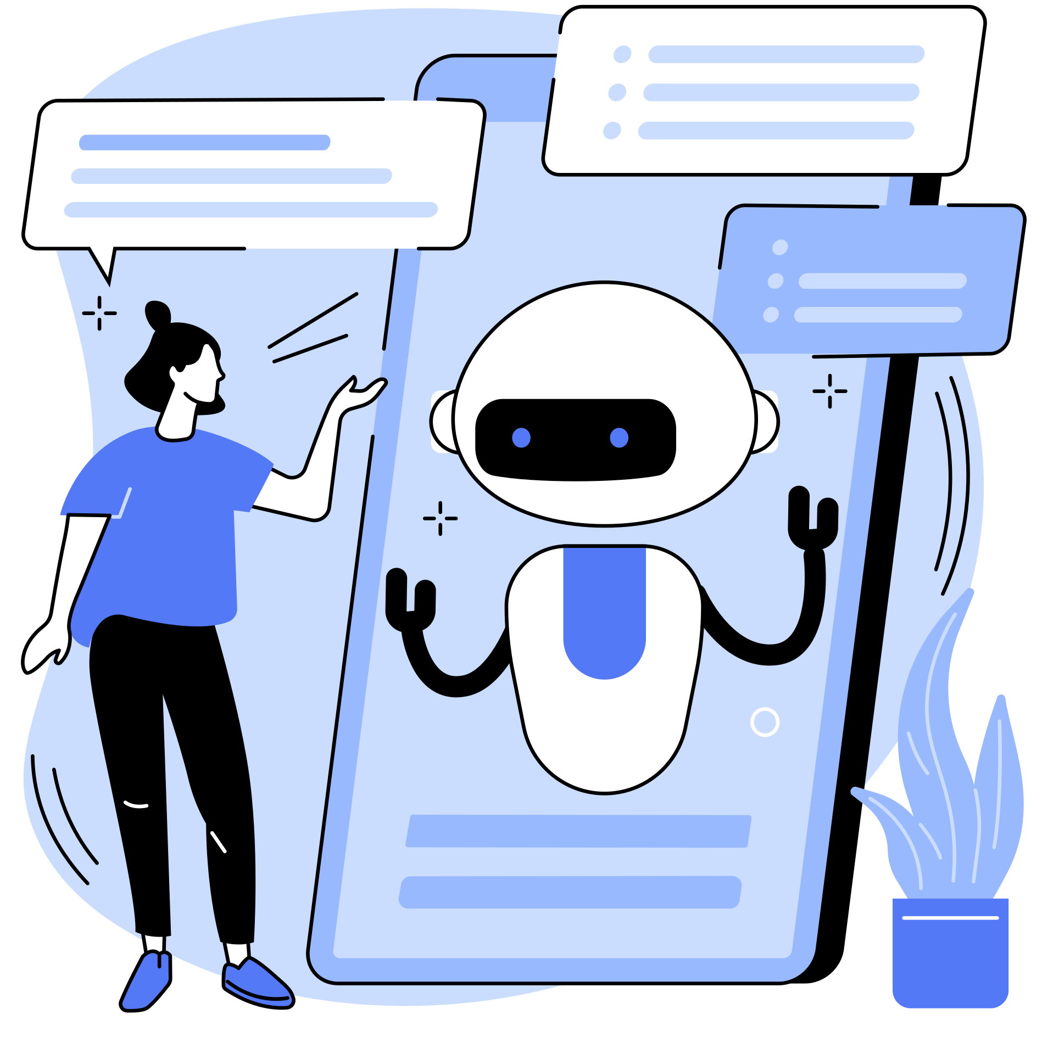
Real-Life Use Cases
  Business: Customer service, content creation.
  Education: Tutoring, homework help.
  Healthcare: Medical research, mental health support.
  Research: Summarizing literature, finding trends.

Slide 9
problems CHatGPT USe can pose
Lack of Personalisation
Bias and Discrimination
Dependence on Technology
Data Privacy and Security
Misinformation
Although AI tools are constantly evolving, they lack the human emotions that are sometimes necessary for effective communication.
Bias can occur in AI systems because of the data used to train them. AI algorithms may reflect societal biases, prejudices, and stereotypes.
Users may become too dependent on technology, hindering their ability to think critically or solve problems.
AI-powered tools in general often collect vast amounts of personal data, which might pose a threat to user’s privacy and security.
ChatGPT only knows information up until its training data’s last update. Thus, it can generate incorrect or outdated information.

Slide 10
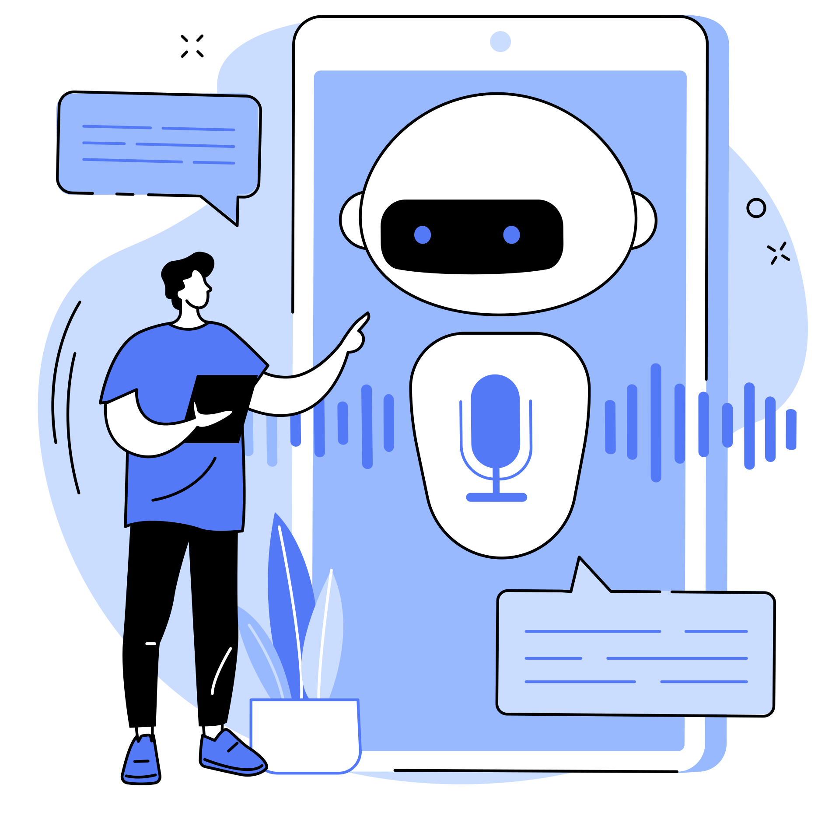
How Can you Benefit?
  Everyday Assistance: Help with scheduling, reminders, weather.
  Learning & Fun: Explaining concepts, storytelling, games.
  Health Tips: Advice on exercises, healthy meals.
  Entertainment: Jokes, trivia, personalized stories.

Slide 11
ChatGPT Competitors
Google Bard
Claude by Anthropic
Microsoft Copilot
Jasper
Google’s conversational AI tool, built to integrate with Google’s vast search capabilities. It offers similar text generation and question-answering features.
A competitor built by Anthropic, a company focusing on AI safety. Claude models offer human-like conversational abilities similar to ChatGPT.
Integrated into Microsoft products like Word and Excel, Copilot uses AI for task automation and assisting with writing and other tasks.
Focuses primarily on content creation and marketing, providing features for writing blog posts, advertisements, and other business-oriented content.

Slide 12
Tips and Tricks for Using ChatGPT
Refining Prompts
Multi-Step Tasks
Tone and Style
Advanced Search
Be specific with your prompts to get the best responses.
If you’re working on something complex, break it down into smaller tasks.
You can ask ChatGPT to adjust its tone or writing style.
Find patterns , summarize key points, or compare data across different fields.
Scenarios
Memory Aids
ChatGPT can act as different characters or simulate scenarios.
Create to-do lists, reminders, or even a study plan

Slide 13
Resources for Further Learning
  Tutorials & Guides
    Udemy (library database)
    YouTube
  Community & Support
    Reddit
    GitHub
    OpenAI’s forum
  Practice Prompts
    Ask ChatGPT to help plan a trip to Paris

Slide 14
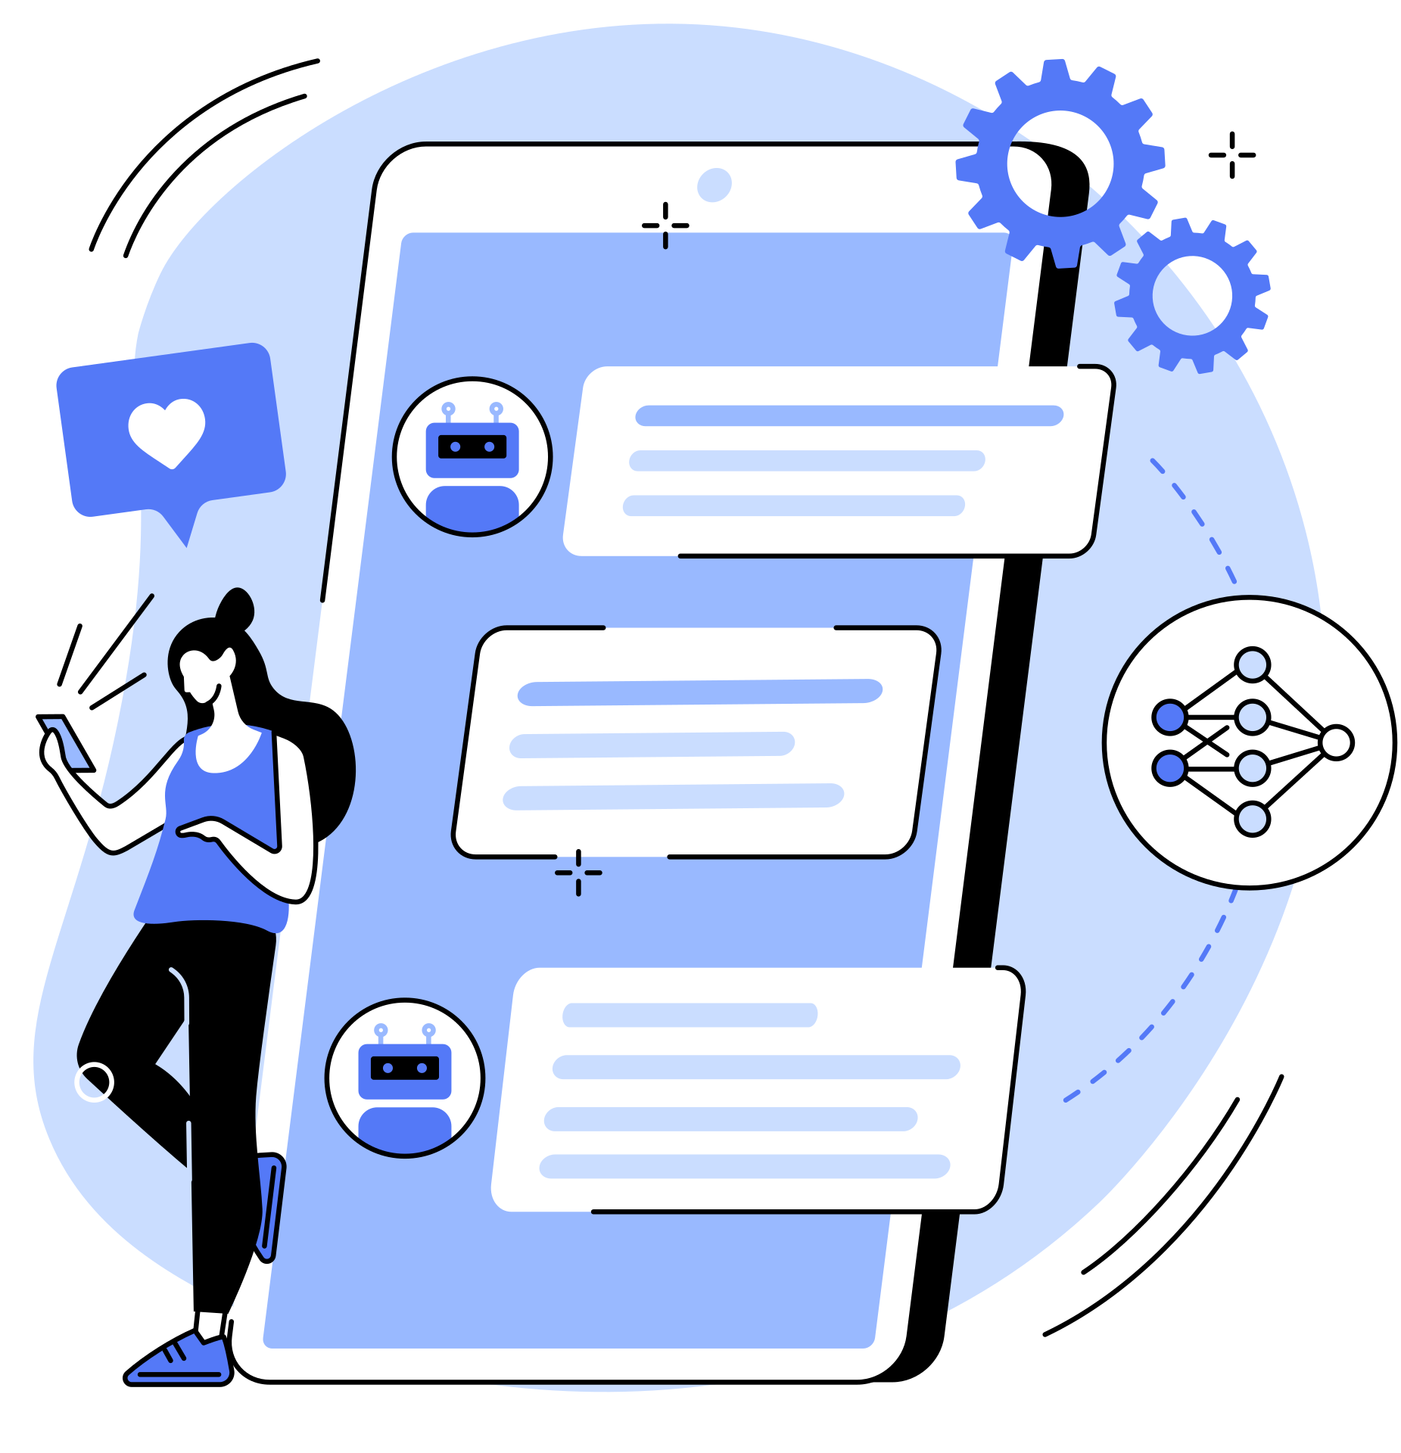
THANK YOU FOR LISTENING!

