Slide 1

Fulshear Branch Library
An Introduction to Microsoft Excel
By Laura Larregui

Slide 2
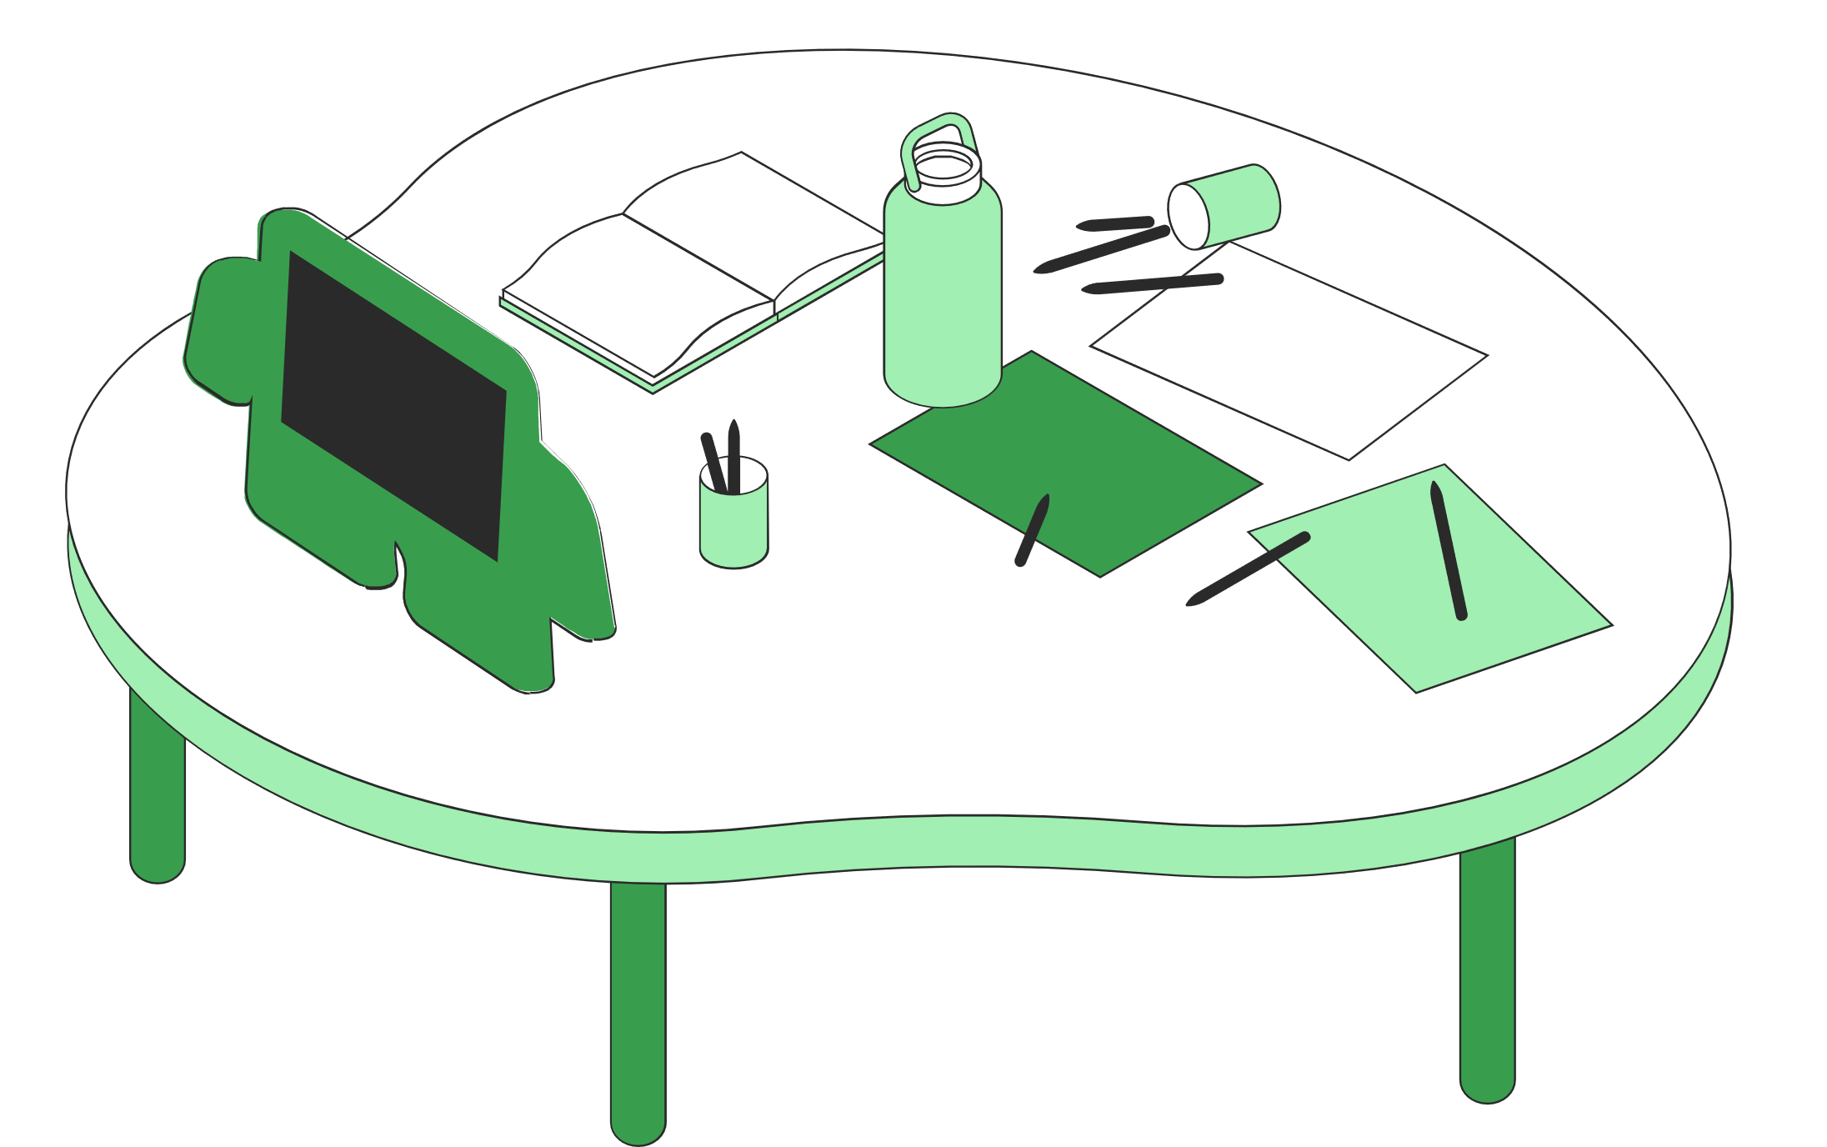
Excel101
Open and create a spreadsheet
What will you learn
Enter data
Use Formulas
Save a spreadsheet
Print a spreadsheet

Slide 3


What is Microsoft Excel?
Excel is a powerful spreadsheet software that allows users to:
  Organize data
  Easily perform complex mathematical equations
  Link information together
  Create charts of data
  And more!

Slide 4

Interface

Slide 5
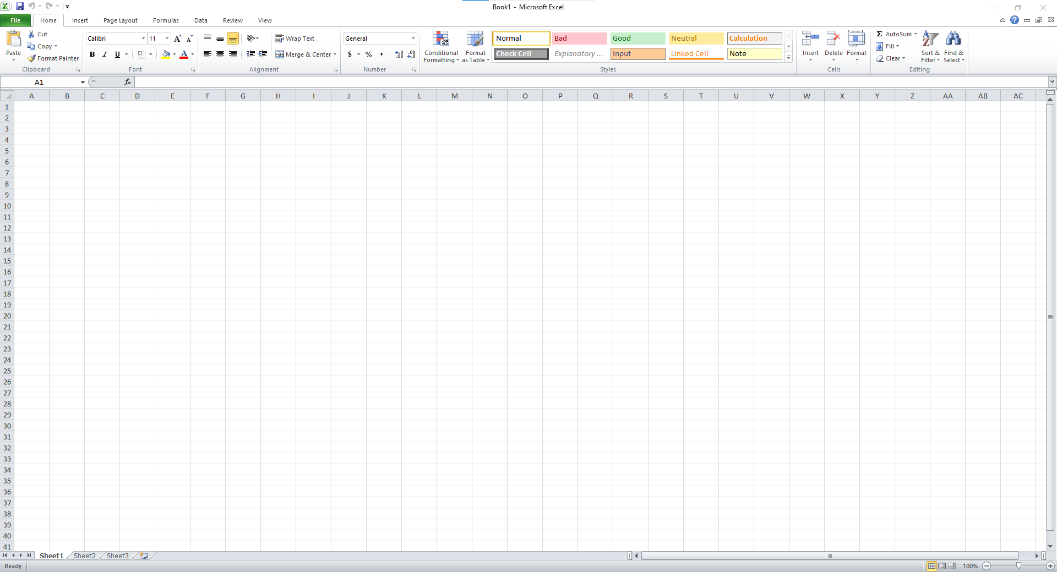
Ribbon
Workbook Name
Columns
Rows
Worksheet Area

Slide 6
Name Box
Cells
Each rectangle in a worksheet is called a cell. A cell is the intersection of a row and a column.
Each cell has a name based on which column and row intersects.
The cell name appears in the name box.

Slide 7
Home Tab: Font Box
Font Appearance allows changes to the text in terms of:
    Type
    Size
    Style: Bold, Italic, Underline
    Borders
    Color

Slide 8
Home Tab: Alignment
  Top/Bottom/Middle Alignment
  Left/Center/Right Alignment
  Orientation
  Indentions
  Text Wrapping
  Merge & Center

Slide 9
Home Tab: Number Box
  Currency
  Percentages
  Comma Style Numbering
  Increase/Decrease Decimal

Slide 10
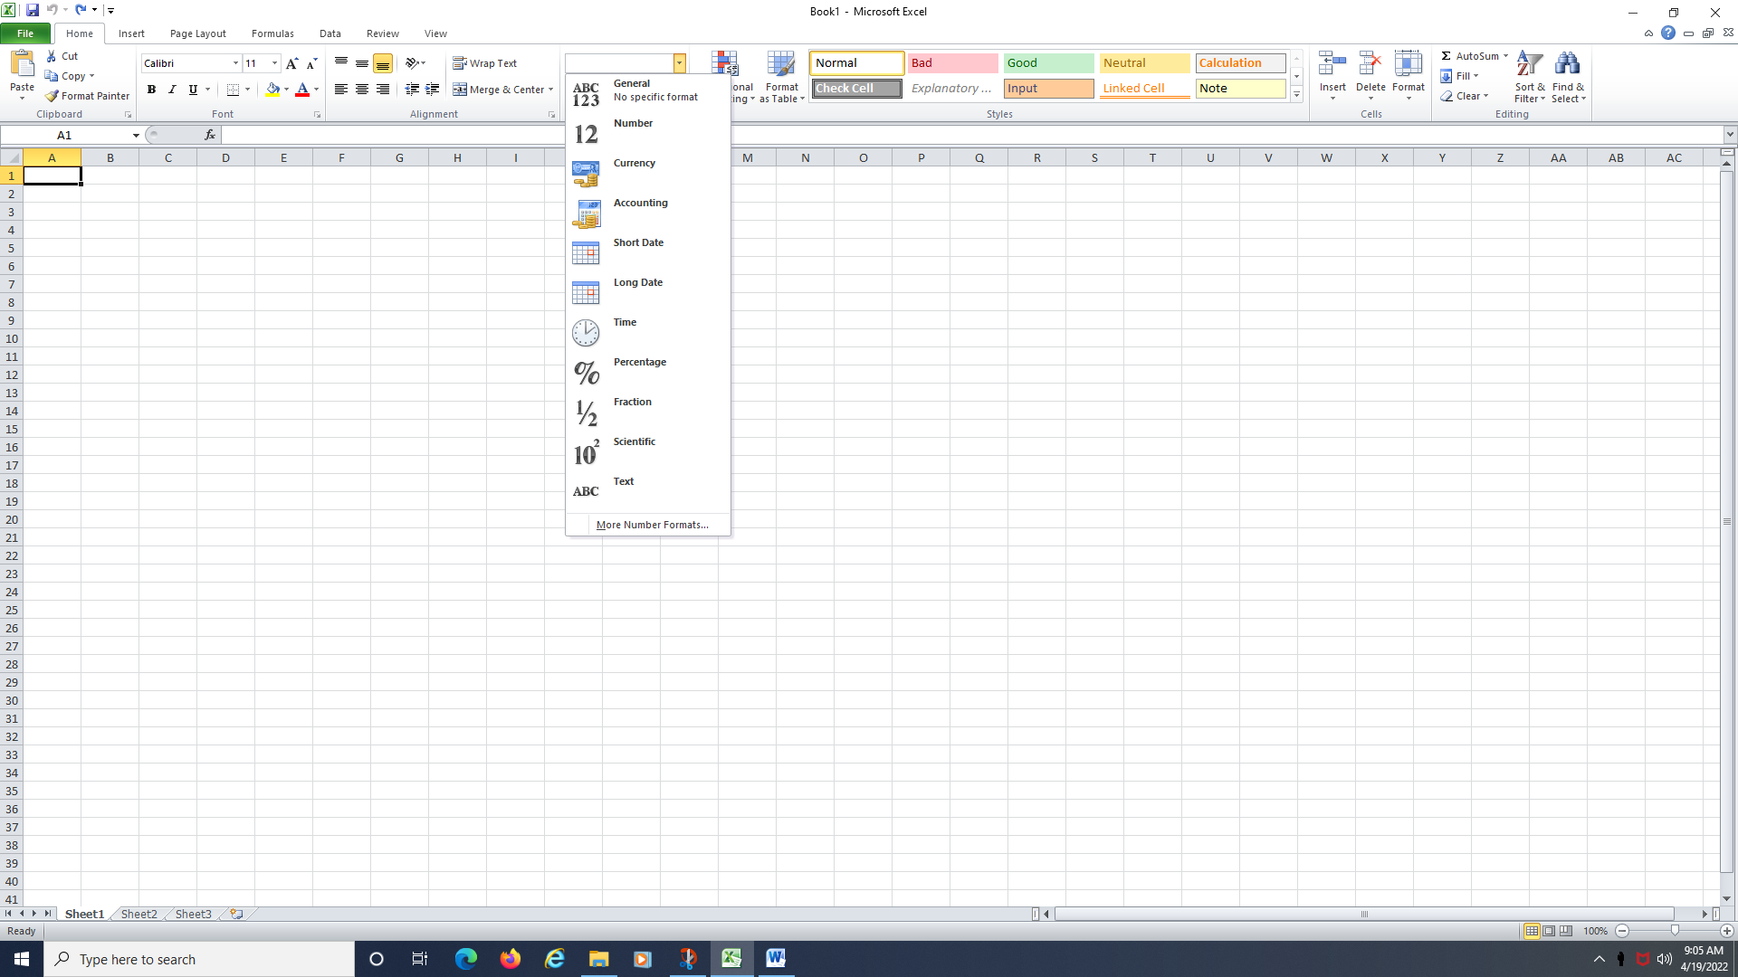
Home Tab: Number Format
  Provides a list of all the available number formats. The built-in number formats are: General, Number, Currency, Accounting, Short Date, Long Date, Time, Percentage, Fraction, Scientific and Text.

Slide 11
Home Tab: Style Box
  Conditional Formatting
  Format as Table
  Cell Styles

Slide 12
Home Tab: Cells Box
  Insert - Insert Cells, Insert Sheet Rows and Insert Sheet Columns, Insert Sheet.
  Delete - Delete Cells, Delete Sheet Rows, Delete Sheet Columns and Delete Sheet.
  Format - Provides an assortment of useful commands that apply to rows, columns and sheets.

Slide 13
Home Tab: Editing Box
  Formulas
  Sort & Filter - Sorts the currently selected data or current region into ascending or descending order
  Find & Select

Slide 14
Addition +
Formulas
  =A1+A2
Subtraction -
  A formula is always entered with an = sign in the front
  Formulas allow Excel to perform calculations for you
  Formulas greatly diminish the amount of data you must manually enter
  =A1-A2
Multiplication *
  =A1*A2
Division /
  =A1/A2

Slide 15
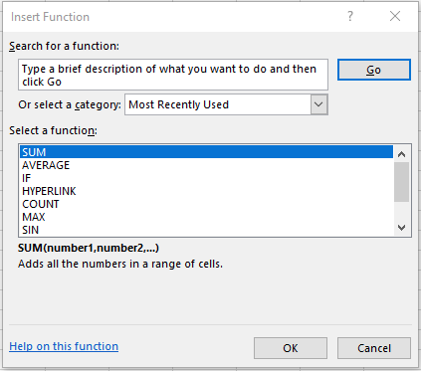

Slide 16
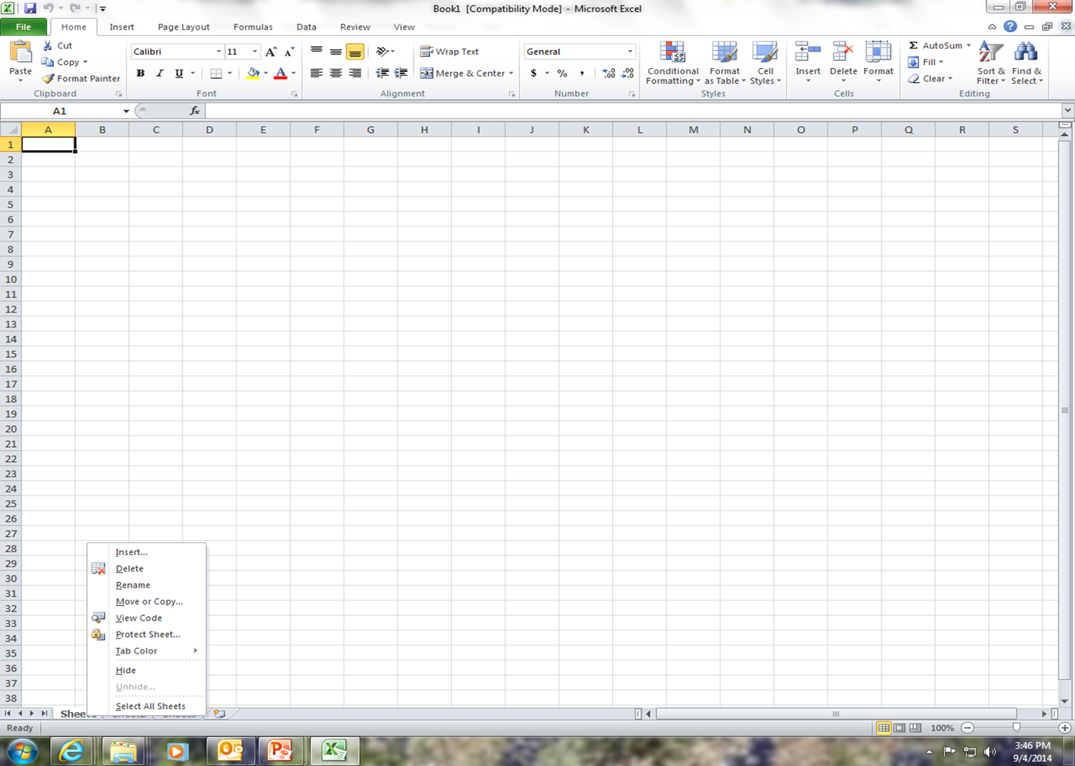
Worksheets
  Worksheets make up the workbook. They can be inserted and/or deleted. They can be password protected.

Slide 17

Let's Practice!

Slide 18

Saving & Printing

Slide 19
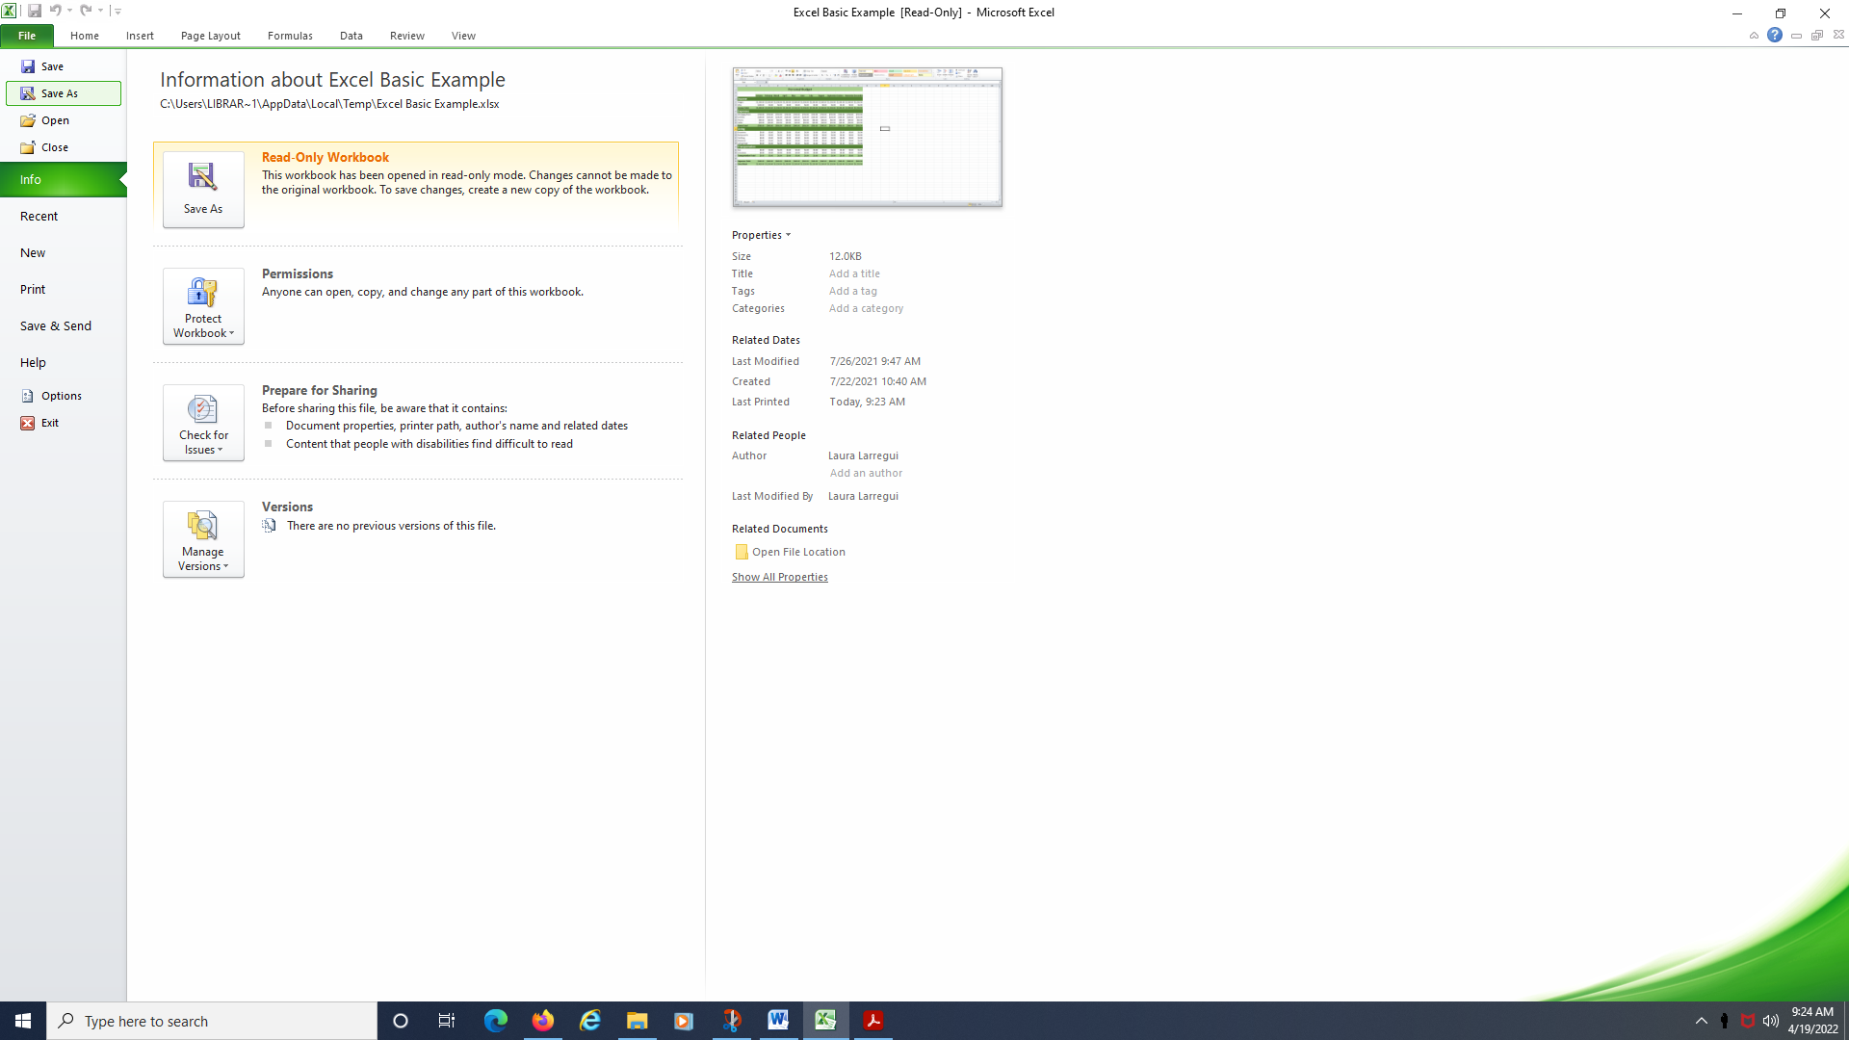
SAVING A WORKBOOK
  Click on 'File'.
  Click on 'Save As'.

Slide 20
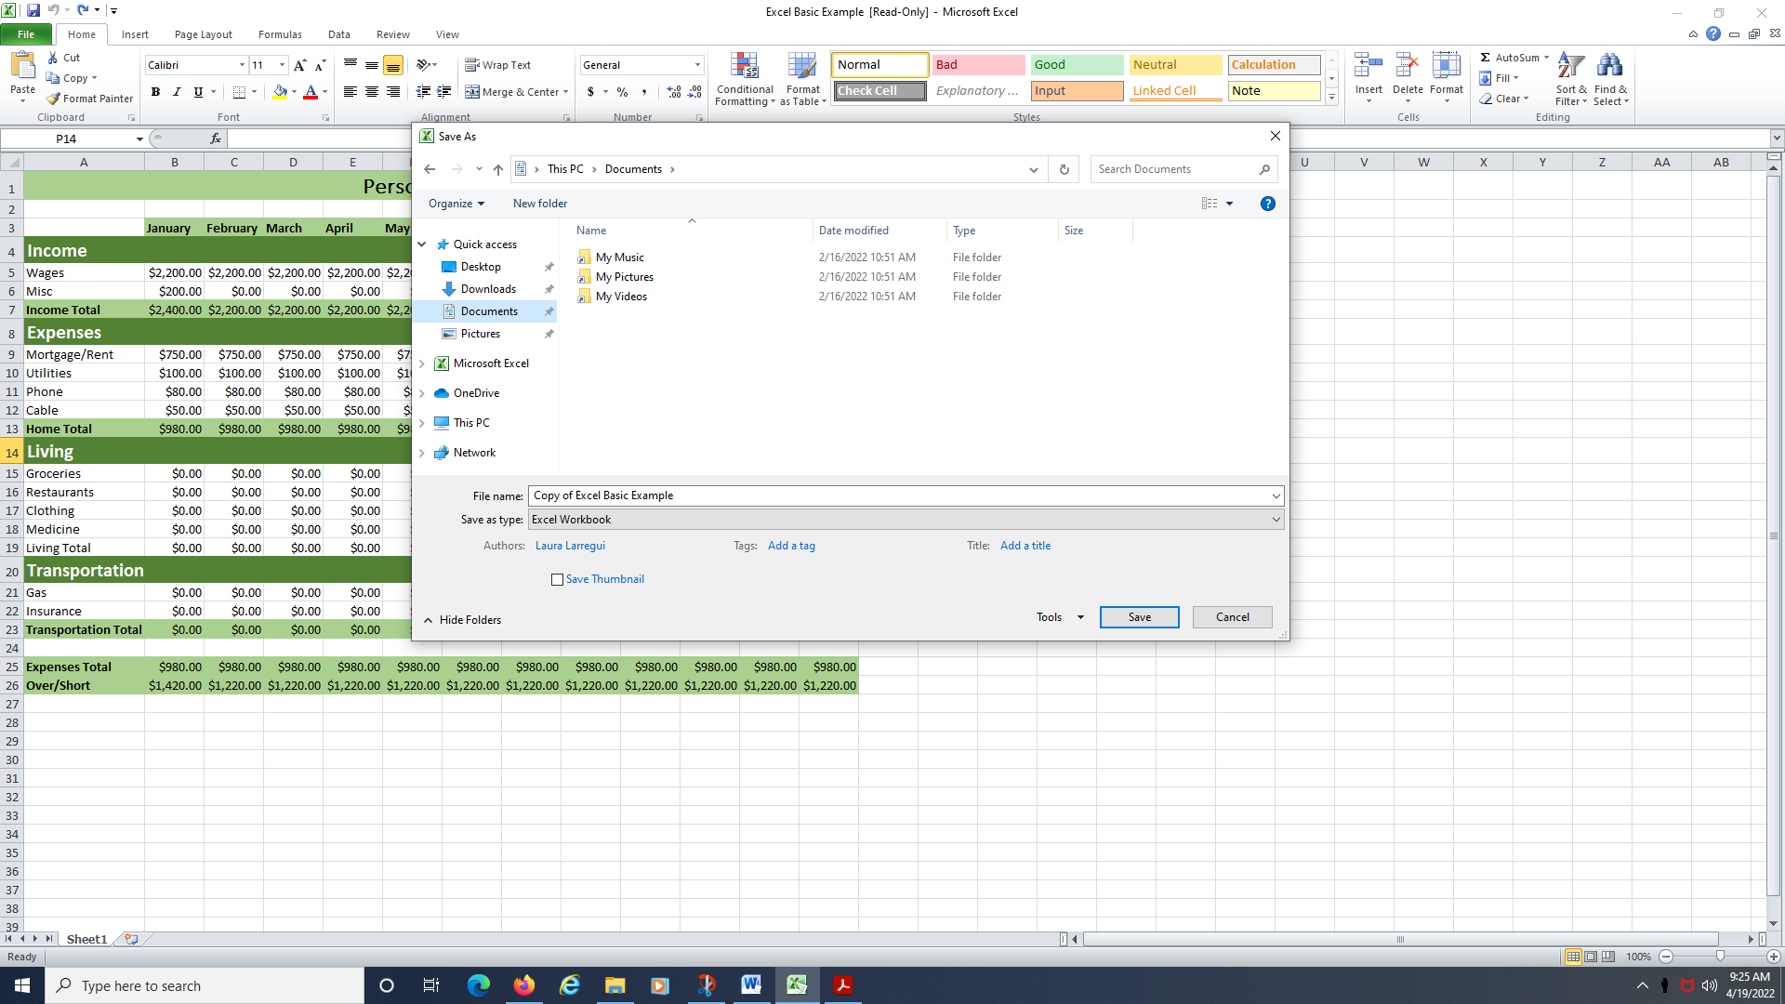
SAVING A WORKBOOK (CONT.)
  Choose a location to save your file. For this activity, choose 'Documents'
  Give the document a name.
  Click 'Save'.
  After saving the first time, click on the floppy disk in the top left corner

Slide 21
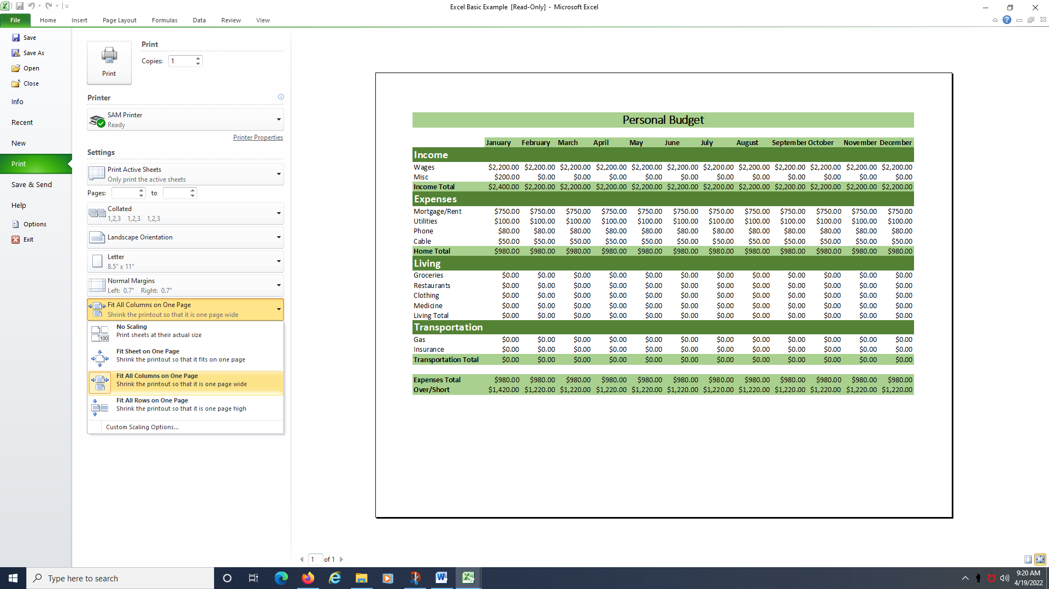
PRINTING A WORKBOOK
  Click on 'File'.
  Click on 'Print'.
  Make sure to select 'Fit All Columns on One Page" or "Fit Sheet on One Page".

Slide 22
Additional Library Resources
Upcoming
Computer Classes
  Brainfuse Adult Learning Center
  Computer Skills Center from LearningExpress Library
  GCFLearnFree.org
  December 10 MS Excel Intermediate
  December 16 Tech Help
  December 17 MS Excel PivotTables

