Slide 1

Microsoft PowerPoint
Basic
FULSHEAR BRANCH LIBRARY

Slide 2

Learning Objectives
  Create a slide
  Add new slides
  Insert different types of content
  Modify text
  Duplicate slide
  Arrange slides
  View presentation
  Print presentation

Slide 3


CREATE A NEW PRESENTATION
Notes:
To create a blank presentation:
1. Select the File tab to go to Backstage view.
2. Select New on the left side of the window, then click Blank Presentation.
3. A new presentation will appear.
Create a presentation from a template.
A template is a predesigned presentation you can use to create a new slide show quickly. Templates often include custom formatting and designs, so they can save you a lot of time and effort when starting a new project.
1. Click the File tab to access Backstage view, then select New.
2. You can click a suggested search to find templates or use the search bar to find something more specific. For example, search for the keyword chalkboard.
3. A preview of the template will appear, along with additional information on how the template can be used.
4. Click Create to use the selected template.

Slide 4
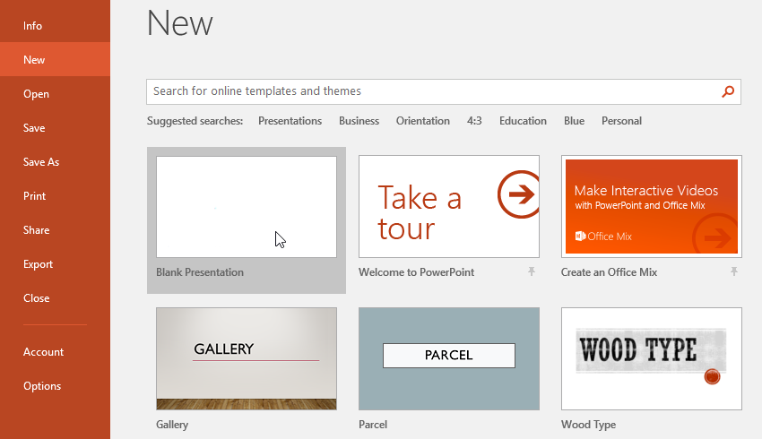

Slide 5
SAVE YOUR PRESENTATION

Slide 6
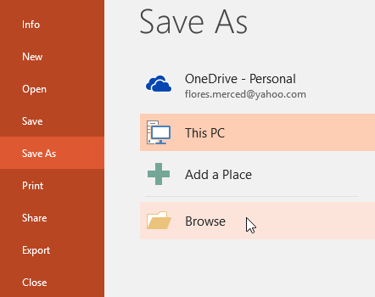
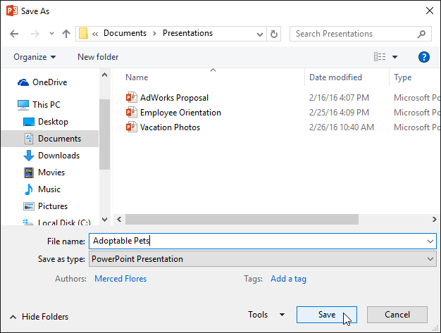
  Locate and select the Save command on the Quick Access Toolbar.
  If you're saving the file for the first time, the Save As pane will appear in Backstage view.
  You'll then need to choose where to save the file and give it a file name. Click Browse to select a location on your computer. Alternatively, you can click OneDrive to save the file to your OneDrive.
  The Save As dialog box will appear. Select the location where you want to save the presentation.
  Enter a file name for the presentation, then click Save.
Notes:
To save a presentation:
It's important to save your presentation whenever you start a new project or make changes to an existing one. Saving early and often can prevent your work from being lost. You'll also need to pay close attention to where you save the presentation so it will be easy to find later.

Slide 7

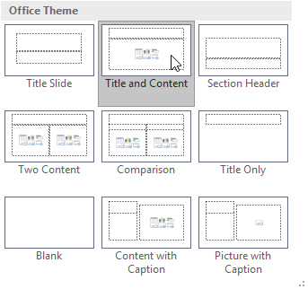
Slides and slide layouts
When you insert a new slide, it will usually have placeholders to show you where content will be placed. Slides have different layouts for placeholders, depending on the type of information you want to include. Whenever you create a new slide, you'll need to choose a slide layout that fits your content.

Slide 8
CHANGE THE LAYOUT OF THIS SLIDE

Slide 9
INSERTING CONTENT

Slide 10

Slides and slide layouts
When you insert a new slide, it will usually have placeholders to show you where content will be placed. Slides have different layouts for placeholders, depending on the type of information you want to include. Whenever you create a new slide, you'll need to choose a slide layout that fits your content.

Slide 11
Notes:
Exercise: Insert an item here.

Slide 12
MODIFYING TEXT

Slide 13
Text Basics
  Main Copy and Bullets:
    Minimum font size: 18 points
    Preferred font size: 24 points
  Headers or Titles:
    Preferred font size: Between 36 and 44 points
Remember that these are general guidelines, and you can adjust font sizes based on your specific presentation needs. Additionally, consider the viewing distance for your audience – if they’ll be seated far away, opt for larger font sizes to ensure readability. As a rule of thumb, aim for simplicity by using consistent font sizes across your slides and limiting the number of different font sizes per slide.

Slide 14
INSERT/DUPLICATE/DELETE SLIDES

Slide 15
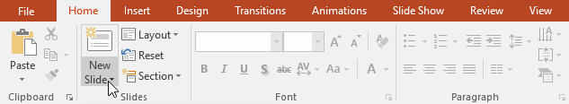
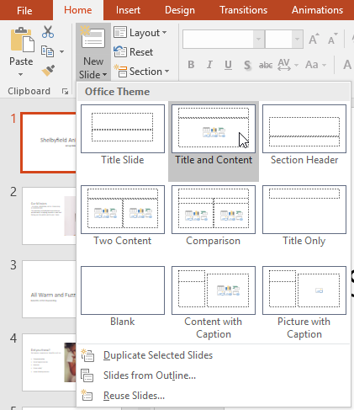
  From the Home tab, click the bottom half of the New Slide command.
  Choose the desired slide layout from the menu that appears.
  The new slide will appear. Click any placeholder and begin typing to add text. You can also click an icon to add other types of content, such as a picture or a chart.
  To change the layout of an existing slide, click the Layout command, then choose the desired layout.

Slide 16
ADD A NEW SLIDE AFTER THIS SLIDE

Slide 17
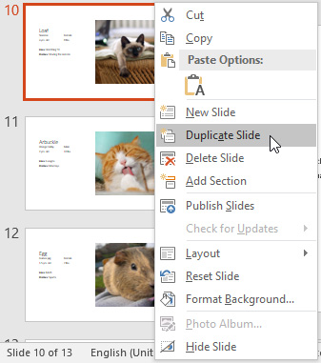
Duplicate Slides
If you want to copy and paste a slide quickly, you can duplicate it. To duplicate slides, select the slide you want to duplicate, right-click the mouse, and choose Duplicate Slide from the menu that appears. You can also duplicate multiple slides at once by selecting them first.

Slide 18
DUPLICATE THIS SLIDE

Slide 19
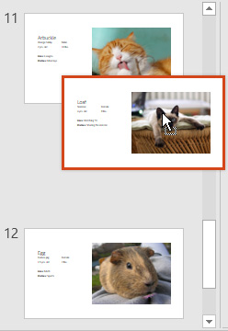
Move Slides
It's easy to change the order of your slides. Just click and drag the desired slide in the Slide Navigation pane to the desired position.

Slide 20
MOVE THIS SLIDE BEFORE SLIDE 14

Slide 21

Delete Slides
If you want to remove a slide from your presentation, you can delete it. Simply select the slide you want to delete, then press the Delete or Backspace key on your keyboard.

Slide 22
DELETE THIS SLIDE

Slide 23
PRINT YOUR PRESENTATION

Slide 24

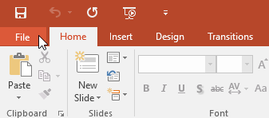
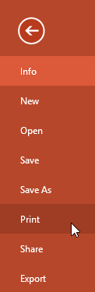
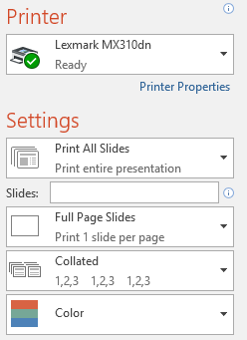
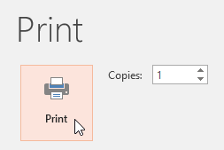
Notes:
PowerPoint offers several layouts to choose from when printing a presentation. The layout you choose will mostly depend on why you're printing the slide show. There are four types of print layouts.
Full Page Slides: This prints a full page for each slide in your presentation. This layout is most useful if you need to review or edit a printed copy of your presentation.
Notes Pages: This prints each slide, along with any speaker notes for the slide. If you've included a lot of notes for each slide, you could keep a printed copy of the notes with you while presenting.
Outline: This prints an overall outline of the slide show. You could use this to review the organization of your slide show and prepare to deliver your presentation.
Handouts: This prints thumbnail versions of each slide, with optional space for notes. This layout is especially useful if you want to give your audience a physical copy of the presentation. The optional space allows them to take notes on each slide.

Slide 25
PRESENTING

Slide 26
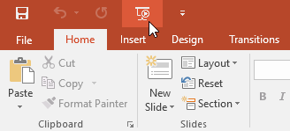
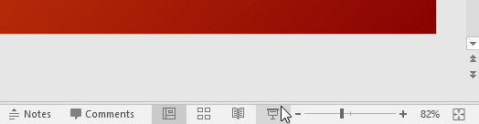
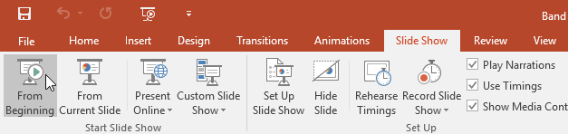
There are 3 Ways to Present:
  Click the Start From Beginning command on the Quick Access Toolbar, or press the F5 key at the top of your keyboard. The presentation will appear in full-screen mode.
  Select the Slide Show view command at the bottom of the PowerPoint window to begin a presentation from the current slide.
  Go to the Slide Show tab on the Ribbon to access even more options. From here, you can start the presentation from the current slide and access advanced presentation options.

Slide 27
Thank you!
Upcoming Classes
May 8 @ 11 am: MS PowerPoint Intermediate
May 15 @ 11am: Drop-in Tech Help
May 22 @ 11 am: Accessing Magazines Online with Flipster
Registration is required.

